Slide 1
What is STEM
WHAT IS
STEM?
Notes:
Put this slide on the screen and ask students:
Does anyone know what “STEM” means?
Ask students to brainstorm in groups, then ask each group to write their guesses on the board.
Then move on to the next slide to start answering the question.

Slide 2
WHAT IS STEM?
SCIENCE!
Biology
Chemistry
Physics
Ecology
Environmental Studies
Notes:
Tell students:
STEM is an acronym. That means that each letter in the word STEM stands for something.
The “S” in STEM stands for SCIENCE.
There are many exciting types of science you can study, including biology, chemistry, physics, ecology, geology, astronomy, and even environmental studies.
Ask students to volunteer the most exciting thing they have studied in science this year.

Slide 3
WHAT IS STEM? TECHNOLOGY!
Computers
Software
Alternative Energy
Artificial Intelligence
Green Technology
Biotechnology
Notes:
Tell students:
The “T” in STEM stands for TECHNOLOGY.
Do you want to be on the cutting edge of new discoveries? If so, you may want to study technology. You can focus on computers and software, or alternative energy, artificial intelligence, green technology such as solar panels or wind turbines, or even biotechnology.
Ask students to call out ways they use technology in their everyday lives: their phone, computer, car, the heat for your school, etc…

Slide 4
WHAT IS STEM? ENGINEERING!
Designing
Building
Using machines
Exploring how things work
Computer Science
Notes:
Tell students:
The “E” in STEM stands for ENGINEERING.
Engineering is a process that solves a real world problem by developing a new product or system. In engineering, a professional identifies the problem, then brainstorms possible solutions after checking for challenges or constraints. Next, the professional identifies an approach and builds a model or prototype, and then refines the design. This is a circular process that strives for continuous improvement.
Ask students to raise their hands if they’ve ever had an idea for a better way to do something: for example, for more features on their better cell phone. If so, they might be interested in engineering!

Slide 5
WHAT IS STEM? MATHEMATICS!
Numbers
Equations
Problems
Algebra
Geometry
Calculus
Notes:
Tell students:
The “M” in STEM stands for MATHEMATICS.
With math, we use numbers and equations to help explain how the world works. When you get to high school, you’ll probably take a lot more math… but you’ll find that it’s a lot of fun!

Slide 6
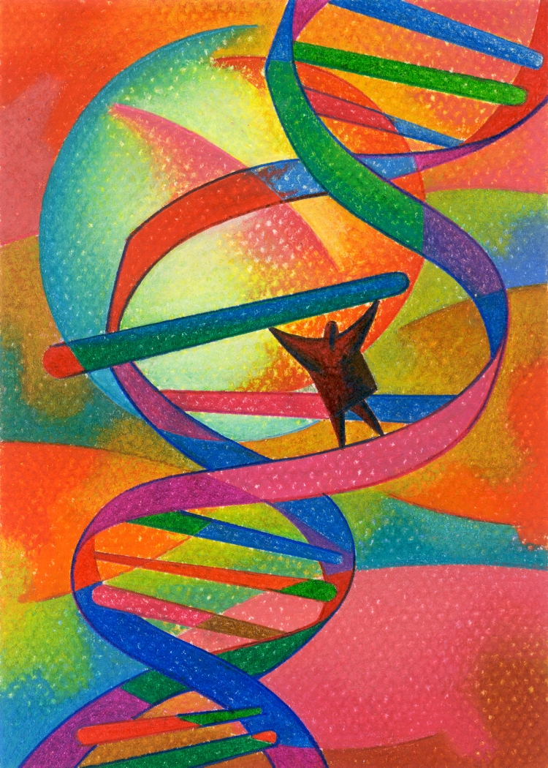
PUT IT ALL TOGETHER
WITH STEM!
STEM gives students the chance to USE their knowledge to solve real world problems
Notes:
What’s most important about a STEM education isn’t just the four individual subjects.
Instead, it’s the fact that STEM will provide students with the abilities to USE strong foundations in science, technology, engineering, and math to solve real world problems. STEM classes are hands-on with lots of applied learning and opportunities to prepare for college and career.

Slide 7
WHY STEM?
EXCITEMENT!
Solve problems
Learn new things
Explore cutting edge ideas
Challenge yourself
Notes:
Ask students to stand up if they think they might be interested in studying STEM. Encourage everyone to stand up!
Tell them:
STEM subjects are very important in the world today. You need to know at least a little about math and science just to live your life.
Studying more about STEM can be very exciting. You’ll learn how to solve problems. You’ll learn new things. You’ll explore cutting edge ideas. And you’ll challenge yourself.

Slide 8
WHY STEM? GLOBAL ISSUES!
Climate change
Natural resource challenges
Global diseases
Skills for the future
Notes:
Tell students:
Another reason to study STEM subjects is because they are very important in the world today. People with STEM skills can help solve climate change and deal with shortages of natural resources, such as gasoline. They can help cure global diseases, such as malaria.
Studying STEM gives you skills for the future.

Slide 9
WHY STEM? GOOD JOBS!
Faster job growth
Higher starting salaries
Better job prospects
Exciting career fields
Notes:
Here’s another reason to study STEM: because STEM subjects lead to good jobs!
Jobs in STEM fields are expected to grow 70% faster than growth for other types of occupations. That means you’re more likely to find a job if you’ve studied STEM. And, with STEM skills you can start out at a higher salary.
STEM also gives you the chance to work in many exciting career fields – from designing video games to creating silicon wafers for computers to maybe even planning the next space mission.

Slide 10
WHY WASHINGTON?
WE’RE A
STEM LEADER!
Second in US for innovation
Fourth in US for tech businesses
67% of new jobs require STEM
Notes:
Ask students:
Do you know why STEM is especially important here in Washington State?
Ask volunteers for their guesses. Then tell them:
We are a STEM leader in Washington State. We are ranked second in the US for innovation and entrepreneurship, and we are fourth in the US for the number of technology businesses.
Washington will be even more STEM-focused in the future: by 2018, about 67% of all new jobs in the state will require STEM skills.

Slide 11
HOW CAN YOU DO STEM?
MATH & SCIENCE!
Take math every year
Take science every year
Join or start a club:
Chess
Robotics
Math Olympiad
Notes:
Ask students:
How can you learn STEM skills?
Ask volunteers for answers. Then tell them:
The best way to learn STEM skills is to take STEM classes in school. That means you should take match and science EVERY YEAR.
In addition, if you are interested in STEM, you can learn a lot by joining or starting a STEM club. Maybe you could join a chess club or participate in Math Olympiad to build your math skills. Or you could join a robotics club or participate in a science fair.

Slide 12
HOW CAN YOU DO STEM? STEM IN SCHOOL!
Ask about STEM programs
in your school district:
Classes
STEM middle or high schools
Community college/CTE
Notes:
Another great way to learn STEM skills is to find out about STEM programs for middle and high school.
You can talk with << Name of school counselor>> if you are interested. S/he can tell you about special classes you can take, as well as other opportunities.
<<This is a great place to get help from your school counselor to provide info on the types of STEM programs offered in your district or through your local Tech Prep Consortium.>>

Slide 13
BE A LEADER WITH STEM!
Notes:
Ask students if they have any questions.

