Slide 1
First Year Immigrant
Personal Pronouns He/Him/His
Evergreen Wolverine 89’
Foodie and Yelper
Listens to Netflix while driving
Serious Husky4LIFE
Married 25 years
80’s Kid
Camp Counselor for 31 years
WEA Human and Civil Rights Coordinator
San Jose City, Philippines
Born
Dad
Proud White Center Grown
High School English Teacher
Star Wars
Videographer/Photographer
2 Daughters, SPU Volleyball, SPU Soccer

Slide 2
Culturally Responsive
Classroom Management
Culturally Responsive
Classroom Management
Ben Ibale

Slide 3
Culturally Responsive Classroom Management
Restoring Hope and Resiliency Through
Classroom Communities
Educator to Whole Class
Educator to Student
Student to Student
Educator to Family
Educator to Educator
Notes:
Ben talk about

Slide 4
Cultural Competency
 | 2018 | 2017 | 2016 | 2015 | 2014 | 2013
Hopeful | 43% | 46% | 47% | 48% | 53% | 54%
Stuck | 36% | 34% | 34% | 34% | 33% | 32%
Discouraged | 21% | 20% | 19% | 18% | 14% | 15%
“The will and skill to create authentic and effective relationships across differences.”
Gary Howard
The only way to increase hope and resiliency is through meaningful caring adult relationships. This is the purpose of the school relationships at every level.
Ben Ibale
Notes:
Ben talk about

Slide 5
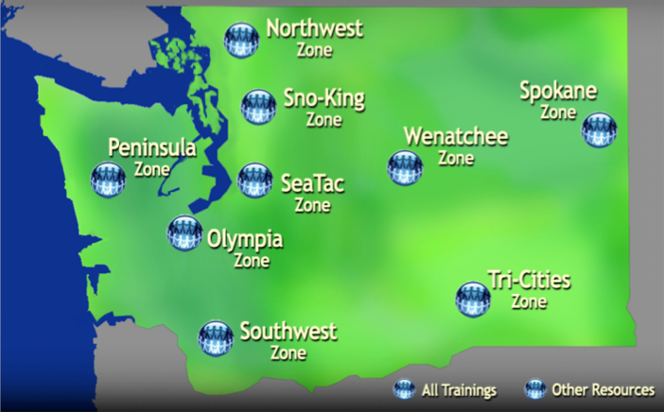
WEA Professional Development Zones

Slide 6

  Educator Lead Training Cadres
Professional Development Training on Issues of Equity
Culturally Responsive Classroom Management
  Education Support Professionals
  Certificated Employees
  $450,000 NEA Grant
ELL Culture, Language and Equity (ESP, Certs)

Slide 7
Goal 1: Improve school conditions for student learning by tracking student discipline data, individual staff survey, and classroom/climate each of the three years of the grant.
-Due to the new PD Network system, evaluations have been inputted by participants electronically after the training has completed as part of the WEA Washington State clock hour system. Unfortunately, that has created a significant loss of survey feedback from participants so we are planning to return to the traditional pencil/pen Educator CRCM satisfaction survey. Our Culturally Responsive Strategies Trainings continue to score very high on our training evaluations with an average
4.24/5.0 Strategies to improve effectiveness
4.05/5.0 Instructor modified instruction
4.14/5.0 Participant will change behavior on job

Slide 8
Goal #2: Identify and train 50 instructional leaders to serve as CRCM Regional Trainers. The CRCM Trainers will receive professional development training on the following: WEA Instructional Leaders on CRCM, Educational Professional Issue Organizers.
WEA has 74 Certificated Trainers, and 8 ESP Trainers. Due to the increased demand in district wide implementation, CRS is investing a larger number of trainers at each collaborative district in order build sustainability and capacity within their own equity leaders among their staff of educators.
• Spokane EA – 6 new trainer at August 14-16, 2019 TOT
• Marysville EA – 7 new trainer at August 14-16, 2019 TOT
• Central Kitsap – 5 new trainers at August 14-16, 2019 TOT

Slide 9
Goal #3: Train 11,107 educators in three years directly impacting the student success of 355,425 public school children.
- Goal in year one 800-1100, trained 3629,
- Goal in year two 1000-1300, trained 2699
- Goal in year three 1200-1500, trained 1480
We have our largest trainings happening in August 2019.

Slide 10
Goal #4: Collaboratively build a CRCM professional learning community website between the WEA and University of Washington with additional national resources through the NEA edCommunity network by August 26, 2016.
We are currently utilizing the NEA edCommunities for our CRS Trainers only to secure our content and newest presentations, Powerpoints and resource guides.

Slide 11
Goal #5: Strengthen collaboration with community partners and communities of color by creating a new list of organizations and leaders engaged on student success and culturally responsive classroom climates.
WEA Councils and Locals
PD Network
Office of Superintendent of Public Instruction (OSPI) Comprehensive Support Schools
University of Washington College of Education Faculty
Kids at Hope and the Hope Center at Arizona State University
Teaching Equity Network
NAACP Tacoma Branch
WEA Educators of Color Networks

Slide 12
Local and Council sponsored 3hr PD
Engages members into association activity around professional practice, equity and social justice.
Promotes the Culturally Responsive Classroom Management series for their schools, programs and districts
Creates a network of educators interested on issues related to equity
Creates association leaders in the classroom, building, local and council

Slide 13
Districtwide Mandatory Implementation Building by Building
Central Kitsap Schools, Spokane Schools, Prosser Schools). Association Leadership collaborates with District Leadership, Supt, School Boards, Principals, staff and bargaining unit members. This includes a 5-6 year implementation plan and rollout of the 4 modules.

Slide 14
One Building Implementation
A majority of the district trainings are building by building based on collaboration between the building principal, local association and the CRS Leadership Team and trainers. The effectiveness of the training increases when staff can focus on strengthening the adult culture in the building in order to impact the student culture.

Slide 15
Two WEA Culturally Responsive Strategies (CRS) Training Options
Option 1: Local Association/UniServ Council sponsors WEA CRS training
  Local/Council Training
Option 2: Local Association and District co-sponsor WEA CRS training
  District Wide
  Administration
  Building Level
  Conference Model
Option 3: Community Based Organizations and Groups

Slide 16
Challenges and Opportunities
No one and done trainings. A minimum of the six hour CRCC/CRCM models with our training cadre along with required coaching support.
  Coaching, classroom research, visits/videos
  Community focus groups, student focus groups
Investing and developing in high quality adult Cultural Competency Trainers takes time.
  Adult learning and training strategies
  Adult cultural competency training and strategies
  Planning time for each training

Slide 17
Central Kitsap 5 Year Equity Plan
Cultural Competency
Respect and Responsiveness to all students and families
Reducing Achievement Gap:
Academic Rigor
Academic Vocabulary
Upper Level Courses
Access
Reducing Opportunity Gap:
Experiences
Resources
Access
EQUITY
Providing each student what they need to be successful
Social-Emotional Learning:
Fostering student voice
Developing authentic student-teacher/staff relationships
Safety and Security
Facilities
Policies
Practices
Notes:
Equity: providing each student what they need to be successful
Cultural Competence: Respect and Responsiveness to all students and families

Slide 18
Timeline
4 year-WEA Module Training
Building Level PD
Equity Team
Fall 2018- Spring 2022 | Fall 2019-Spring 2023 | Fall 2020-Spring 2024
CO, CV, WO CKMS, FMS, KLSS, CKHS, OHS | CC, HE, GM, PI, SI BCCS | BR, EH, EM, SR RMS
 | Dept TBD | Dept TBD
Notes:
JZ
Three Cohorts
Cohort Year 1 starts Fall 2018

Slide 19
Cultural Competency
“The will and skill to create authentic and effective relationships across differences.”
“Fostering hope across differences in order to increase resiliency and academic success for students”
Notes:
Ben talk about

Slide 20
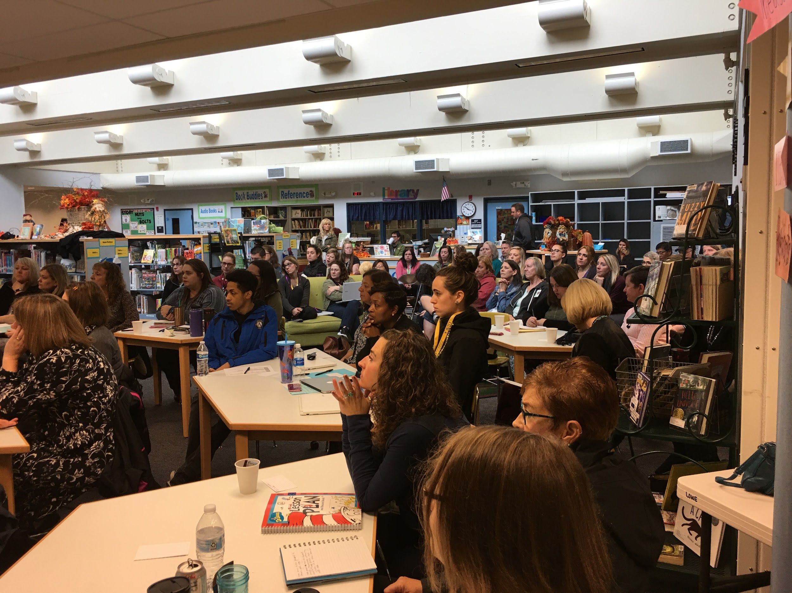
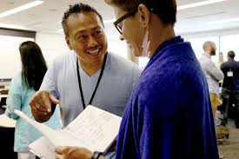
Professional Development
4 WEA Modules
Year 1 - Culturally Responsive Classroom Communities
Year 2 - Culturally Responsive Classroom Management
Year 3 - Culturally Responsive Classroom Interactions
Year 4 - Culturally Responsive Classroom Behavior Interventions

Slide 21

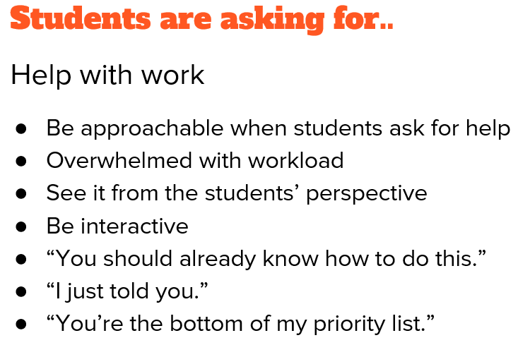
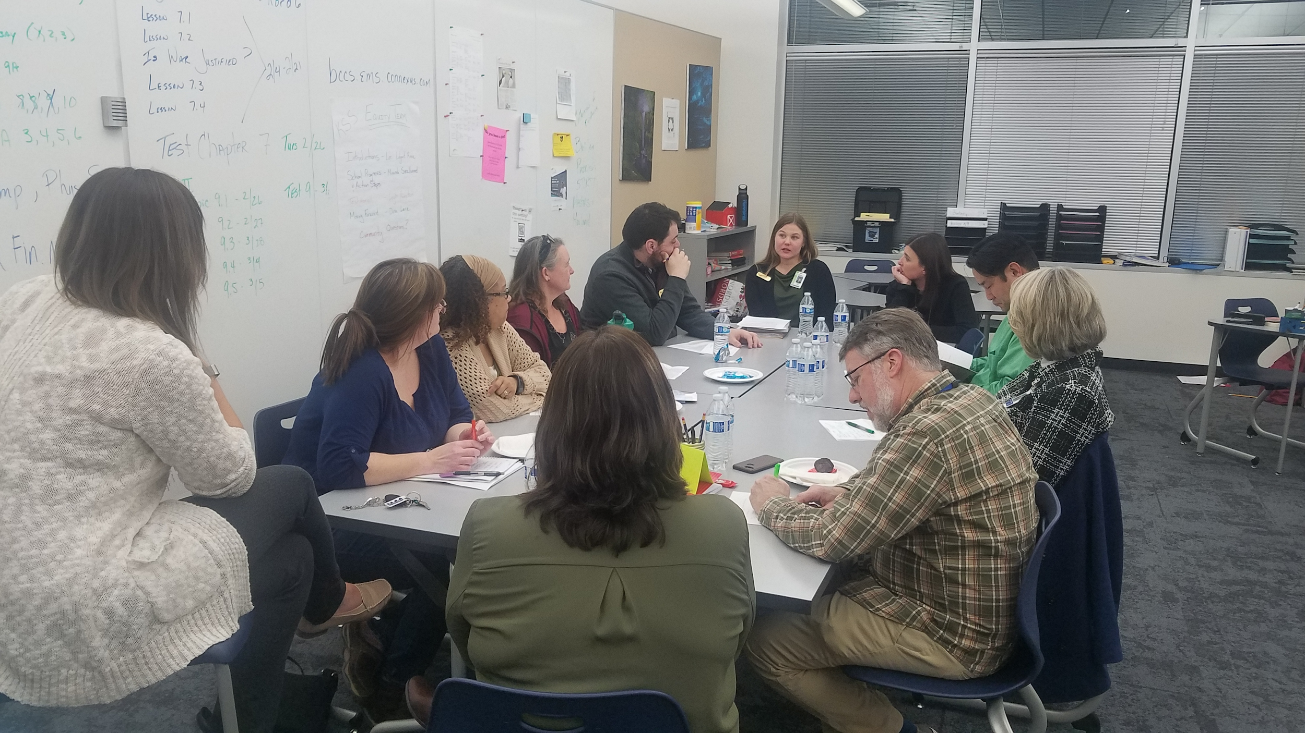
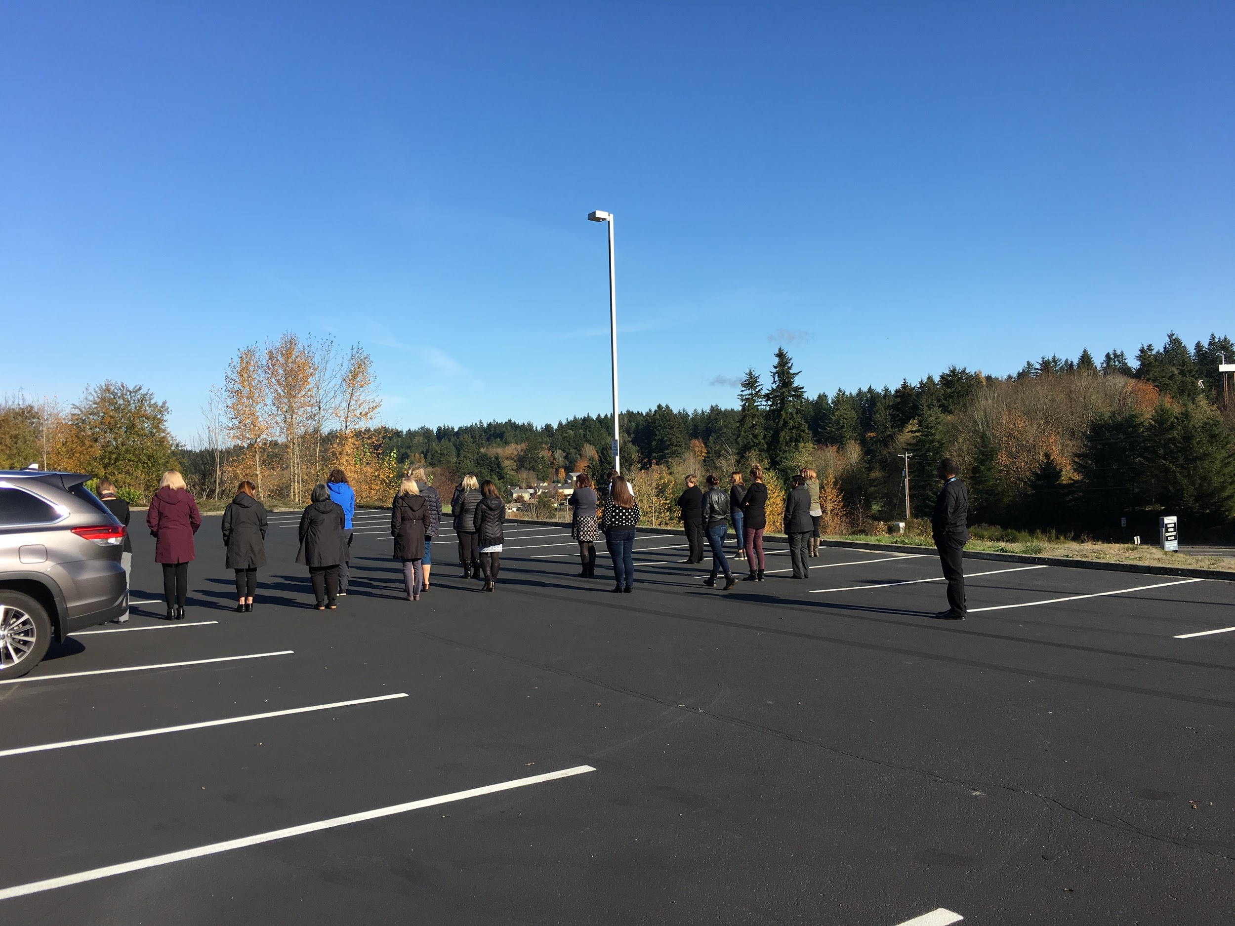
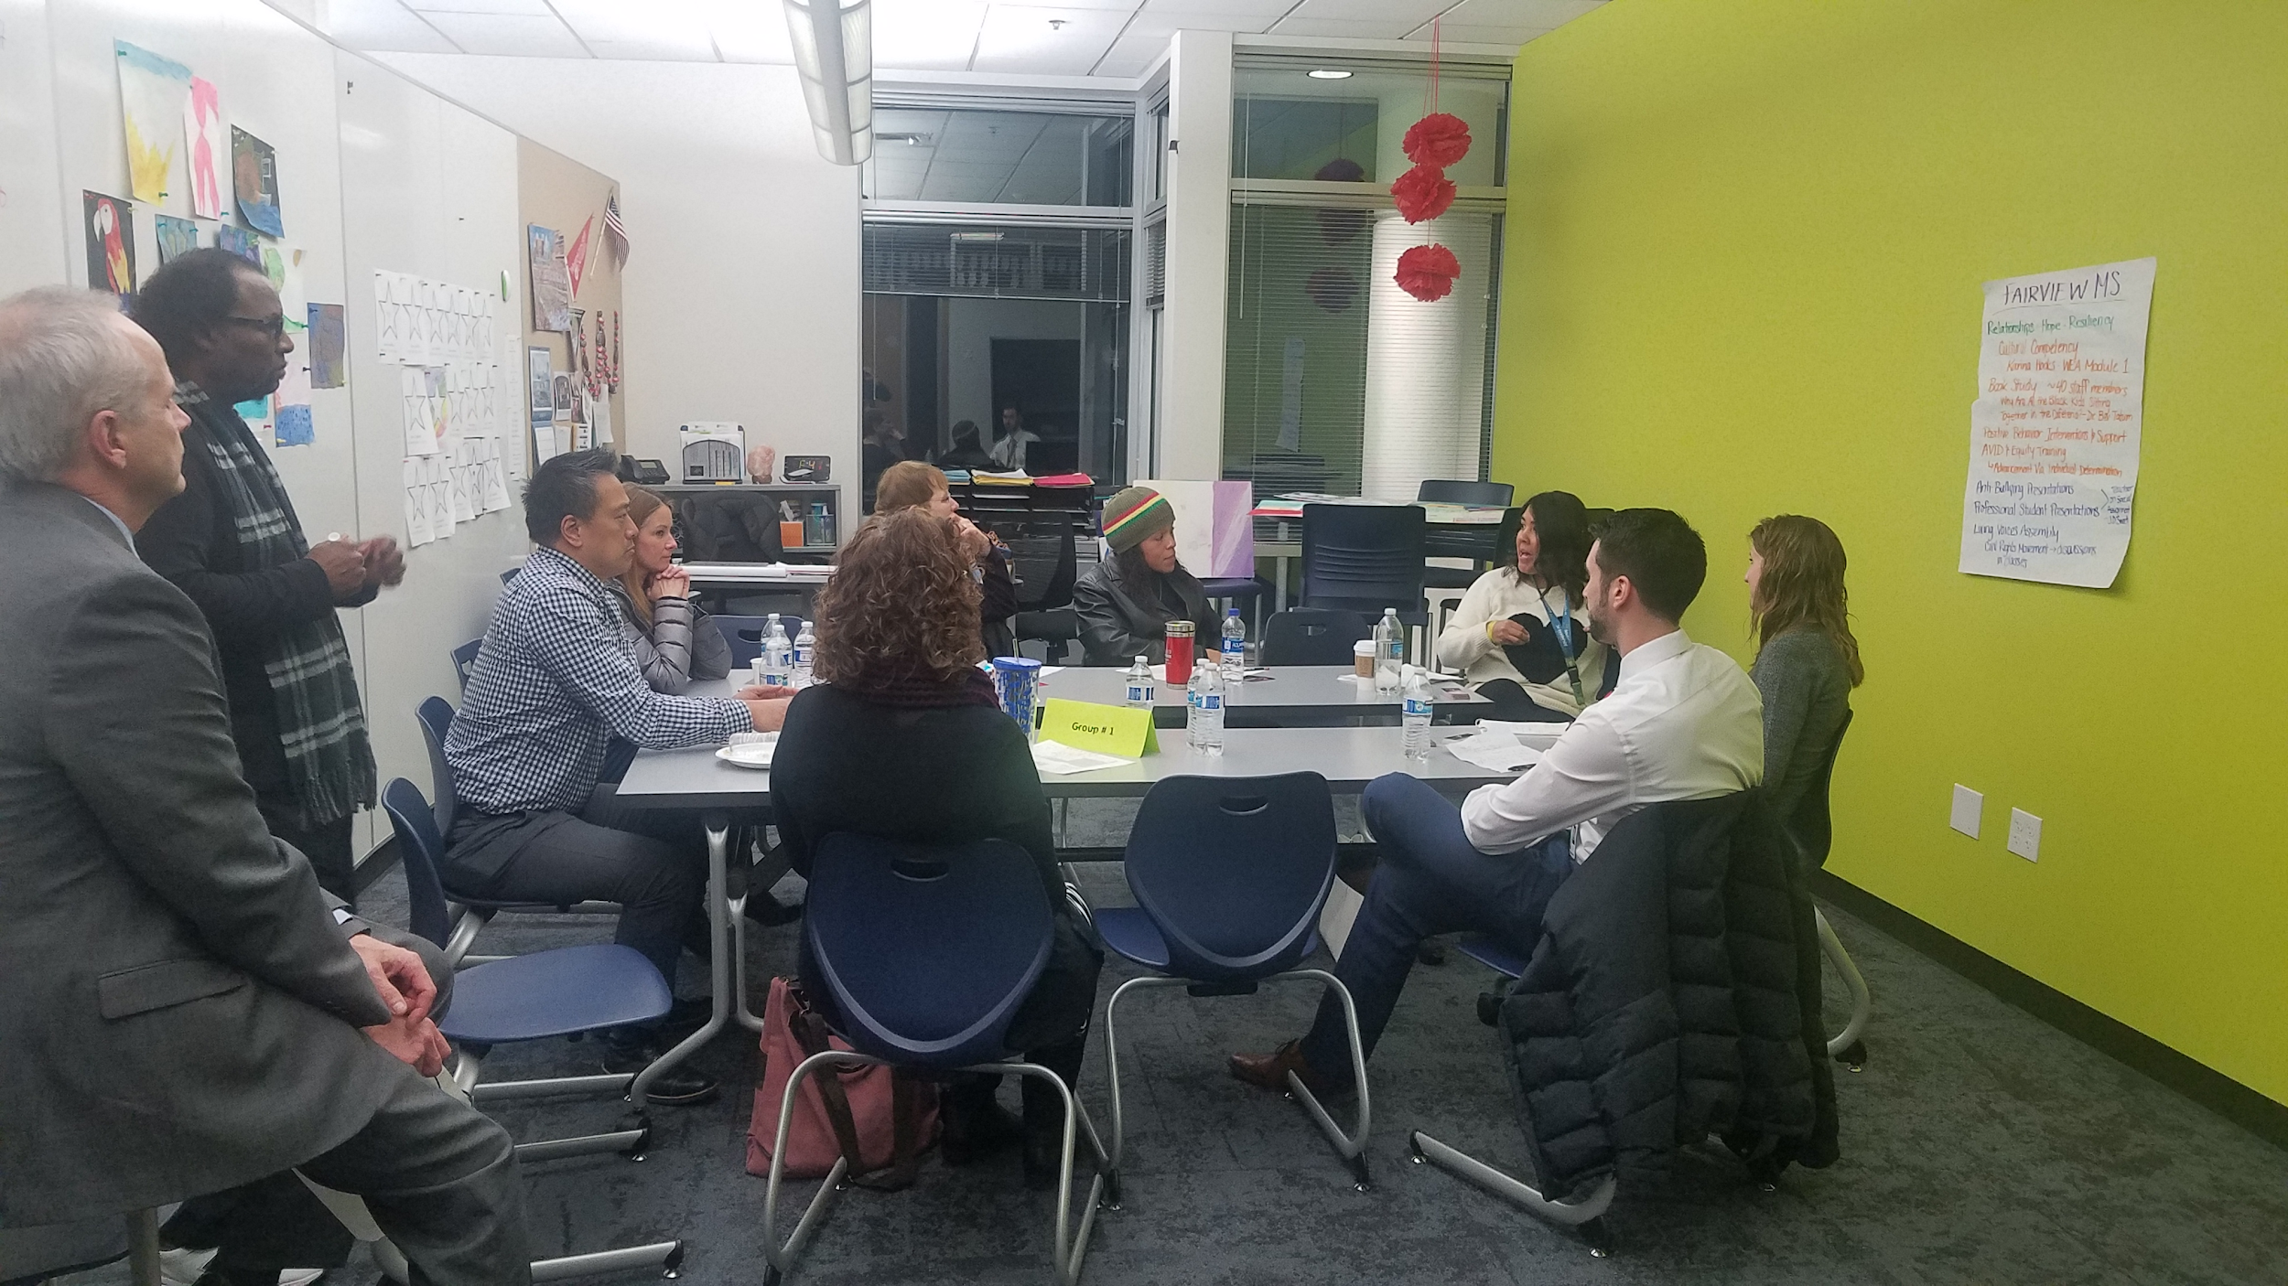


Teacher On Special Assignment (TOSA) Activities

Slide 22
Success Criteria
By the end of the 2023-24 school year:
  District and school survey data shows improved levels of inclusivity.
    Healthy Youth Survey
    CEE Parent/Student/Staff data
  Student performance, discipline, and attendance data shows closing of achievement and opportunity gaps.
  Equity team reports evidence of equitable practices present throughout the district.
Notes:
Jeni-
Survey data
Performance data
Evidence of equity team practices

Slide 23
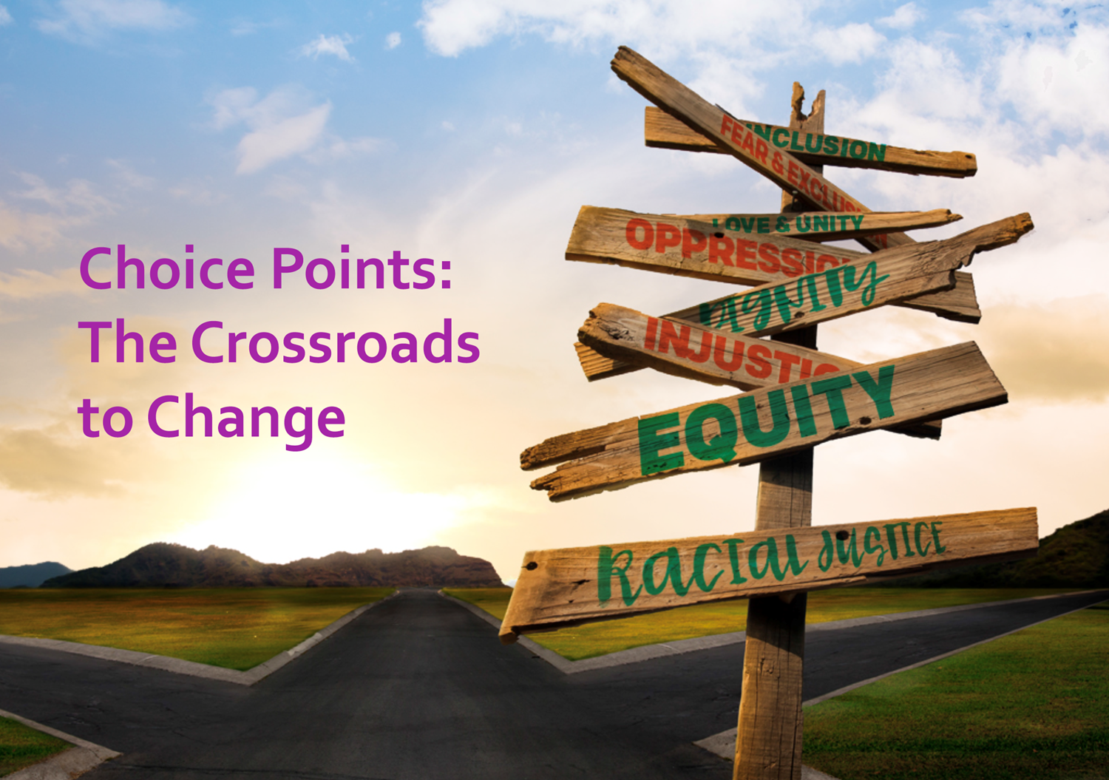
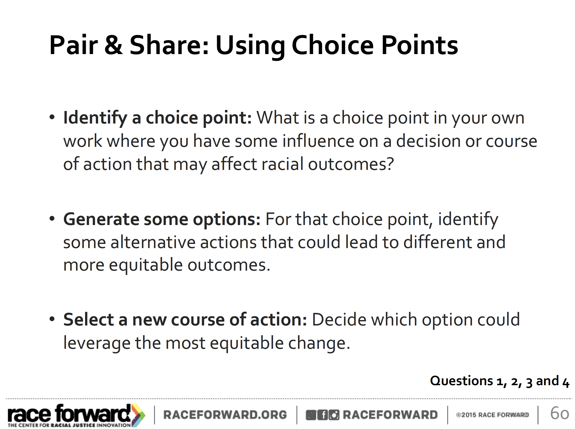
Choice Points: The Crossroads to Change

Slide 24
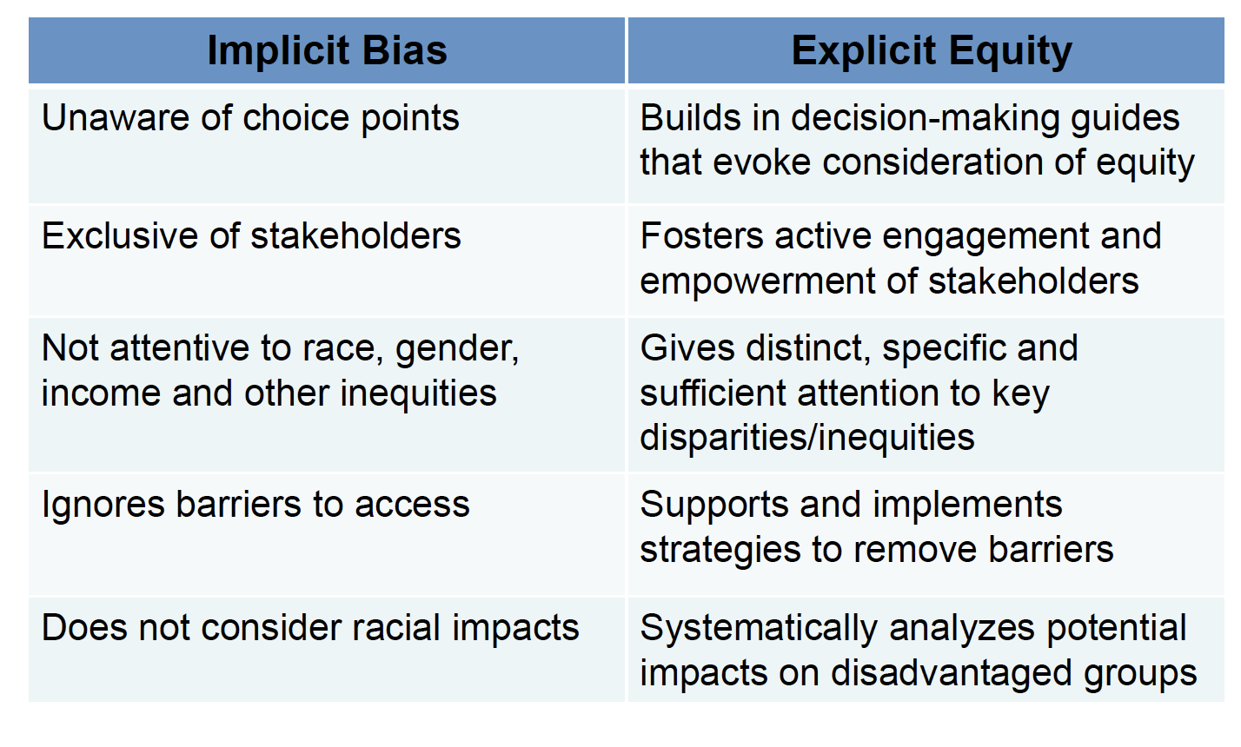
Institutionalizing Racial Equity

Slide 25

IDENTITY
TASK
Efficiency and Bureaucracy
Academic Requirements, Tests, Curriculum
RELATIONSHIP
Focus on Interpersonal
Cultural Competency - WILL and SKILL to create AUTHENTIC relationships across difference
Focuses on group work and goals
Teacher to Student, Teacher to Whole Class, Student to Student
Graduation
Notes:
Patricia –Definition process. 12:55 – 1:05
School quality and student success indicators
Chronic absenteeism –poverty proxy
9th grade on track to graduate – poverty proxy
Dual Credit Participation – IB, AP, CTE classes, college credit and certification
High School and Beyond Plan completed in 8th grade
Have a blank slide

Slide 26
IDENTITY
TASK
New WA
Discipline Laws
RELATIONSHIP
SQSS Indicators
High School and Beyond Plan
-Chronic Absenteeism
- 9th Grade on Track to Graduate
Notes:
Patricia –Definition process. 12:55 – 1:05
Patricia –Definition process. 12:55 – 1:05
School quality and student success indicators
Chronic absenteeism –poverty proxy
9th grade on track to graduate – poverty proxy
Dual Credit Participation – IB, AP, CTE classes, college credit and certification
High School and Beyond Plan completed in 8th grade
Have a blank slide

Slide 27
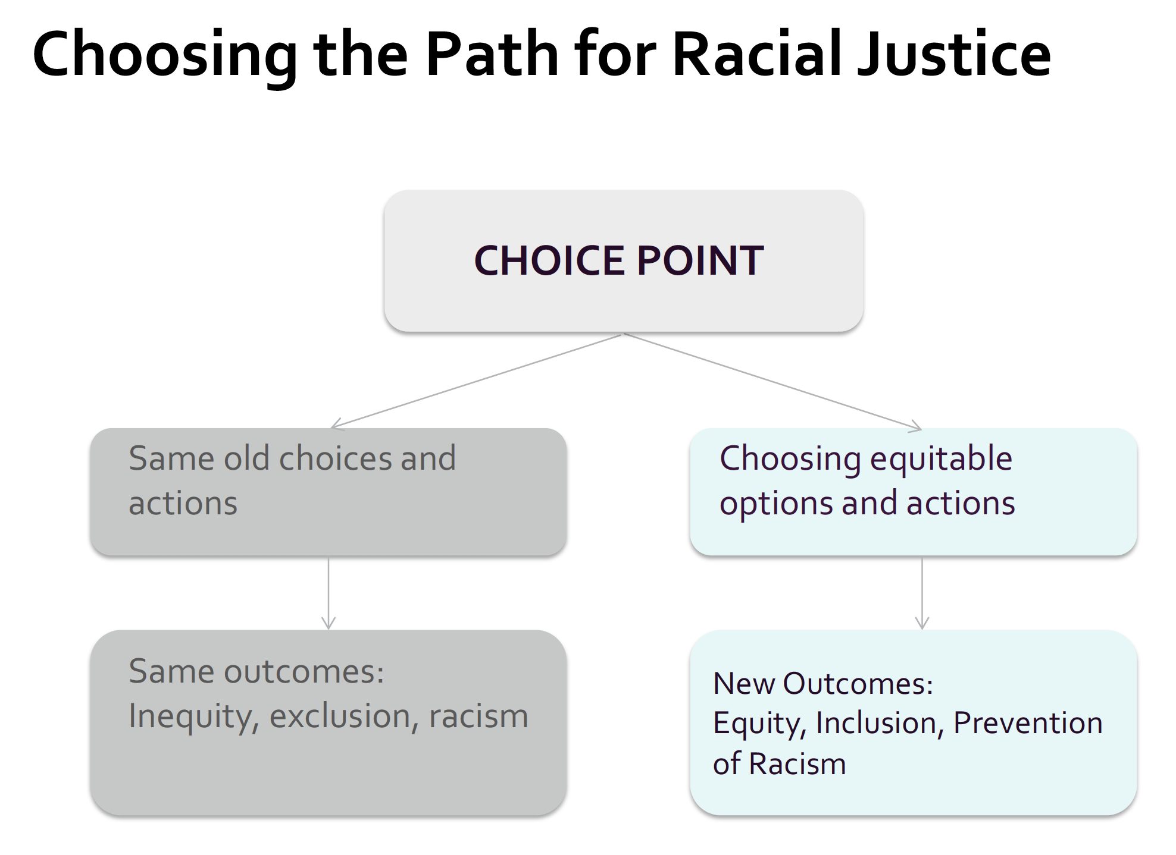
Choosing the Path for Racial Justice

Slide 28
New Washington Discipline Laws
Limit the use of exclusionary discipline for behaviors that do not present a threat to school safety
  Prohibits using suspension or expulsion for tardies and absences
  Encourages refraining from suspending or expelling student unless behavior threatens students or staff
Prohibits the use of expulsion for students in kindergarten through grade four
Requires students the opportunity to receive educational services during a suspension or expulsion.
Ensures students due process rights when discipline is applied
Increases communication with families and encourage their involvement with discipline polices and practices
Encourages best practices related to discipline (exclusions at recess for example)

Slide 29
Framework for Increasing Equity in School Discipline
Prevention
© 2017 by American Educational
Research Association

Slide 30
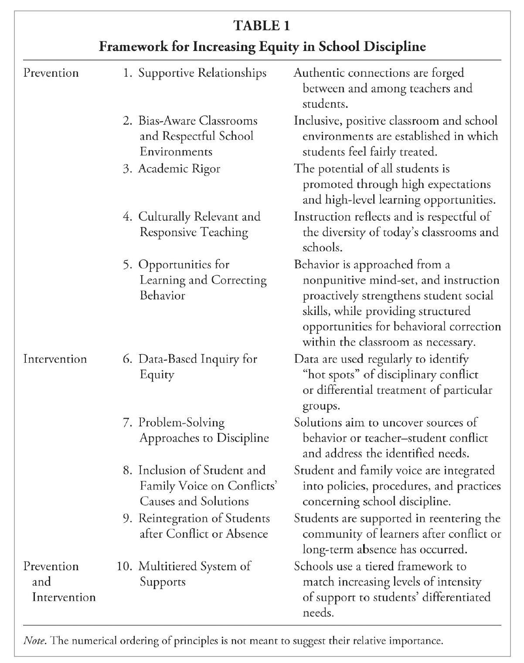
Intervention
Intervention
Prevention and Intervention
© 2017 by American Educational
Research Association

