Slide 1
March GATE Equity Webinar Students with Disabilities: Implementing & Sustaining Inclusionary Practices
Exploring topics related to equity in graduation success
The webinar will begin soon.
While you wait, please share in the chat panel:
What do you see as the
benefits of inclusion?

Slide 2
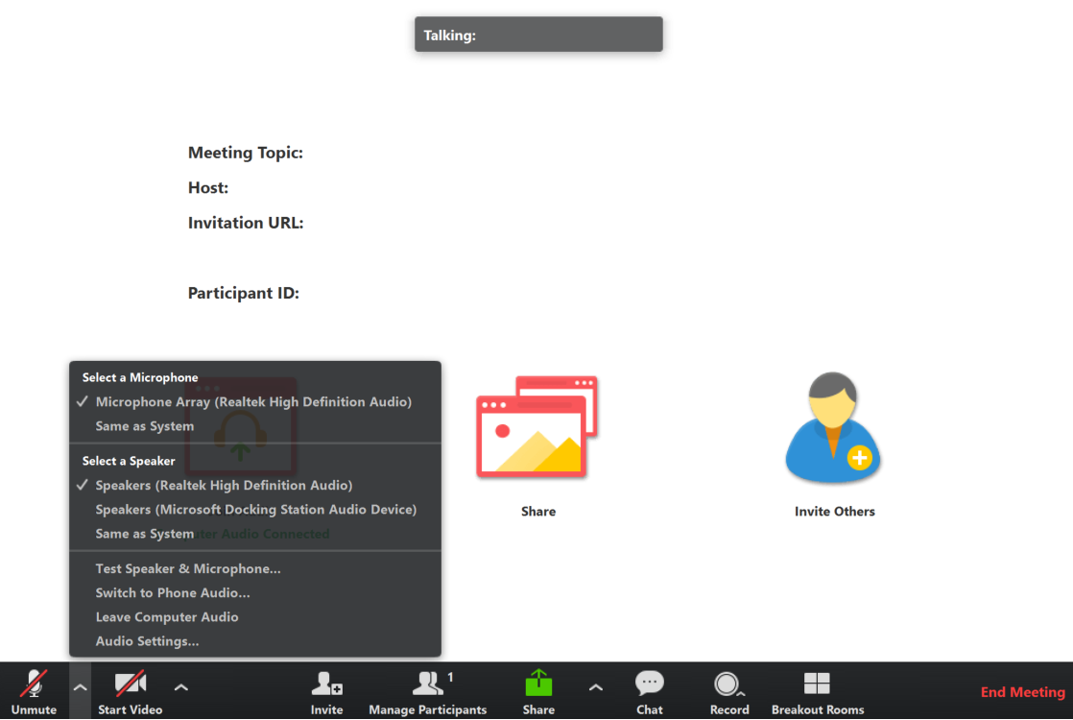
Connect to Audio
Welcome to the GATE Equity Webinar!
We’ll be starting in a few minutes.
You can join by computer audio or call in.
Dial +1 669 900 6833 or
+1 646 558 8656
Webinar ID: 122-657-497
Test Audio
Notes:
We’re going to get started in a few minutes. You can test your audio in the bottom left hand corner of the menu.

Slide 3
Sound Check
Welcome to the GATE Equity Webinar!
We’ll be starting in a few minutes.
We’re going to get started in a few minutes.
Can you hear us?
Please let us know in the chat!
Test Audio
3/11/2020 | 3
Notes:
We’re going to get started in a few minutes. You can test your audio in the bottom left hand corner of the menu.

Slide 4
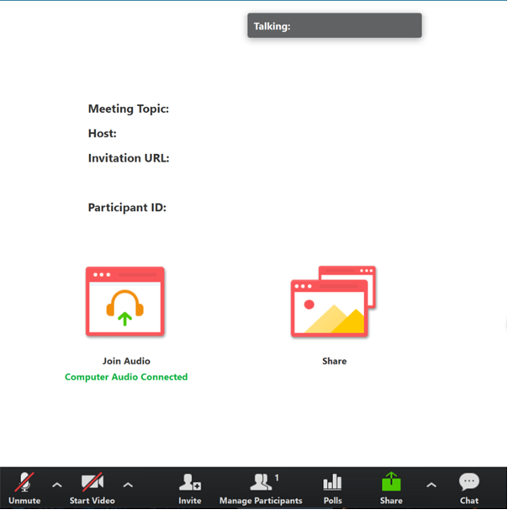
Tips for Participating
Share comments and ideas in the Chat panel (send to “All”)
Ask presenters questions in the Q&A panel
Slides are available on the GATE Equity Webinar page in the Archive now.
Recording will be available at the end of the month.
3/11/2020 | 4
Notes:
Thank you for sharing comments and ideas in the chat.
If you’d like our presenters to answer a question, please use the Q&A instead.
Our slides are available on the GATE Equity Webinar page now if you would like a copy.
We do record our webinars and they’re also on our page in the archive section. The recording from today should be available by the end of the month.

Slide 5
Webinar Etiquette
Focus on the topic, stay present
Assume positive intent
Growth mindset
3/11/2020 | 5
Notes:
As we go through the webinar, please keep this webinar etiquette in mind.
We encourage a growth mindset, where you are open to thinking about new ideas and willing to push yourself to grow.
As with any professional development you’ll get out of it what you put into it. So thank you for staying present, focused, and positive!

Slide 6
March GATE Equity Webinar Students with Disabilities: Implementing & Sustaining Inclusionary Practices
Exploring topics related to equity in graduation success
The webinar will begin soon.
While you wait, please share in the chat panel: What’s your connection to students with disabilities?
Notes:
Thank you for joining us for the March GATE Equity Webinar!
I’m Kefi Andersen, OSPI Graduation Equity Program Supervisor.
Today’s topic is Students with Disabilities: Implementing & Sustaining Inclusionary Practices
We chose this topic because as a state we’ve noticed that many of our students with disabilities are not in the least restrictive environment and we want to help them experience inclusionary practices.
Least Restrictive Environment (LRE) is determined by the IEP team. Each school can check the percentage of time students are in their least restrictive environment. ​
One of the defining principles of special education law is that students with disabilities should be included in the general education program and with nondisabled peers to the maximum extent possible,
and that removal from the general education environment only occurs if the nature or severity of the disability is such that education in the general education classes with the use of supplementary aides and services cannot be achieved satisfactorily.
Least Restrictive Environment (LRE) is determined by the IEP team.​​
Our hope is that by educational leaders will take a look at how many students are experiencing least restrictive environment and consider some of the inclusive practices we’re introducing today.

Slide 7
Do You Need Clock Hours?
We are offering 3 free Clock Hours for attending both of today’s webinars.
Register for clock hours.
Complete the pre-reading assignment.
Attend both the morning and afternoon live GATE Equity Webinars.
Complete the PDEnroller Evaluation.
Clock Hours will be released when attendance is verified, within a week.
Questions? Contact Ronnie.Larson@k12.wa.us
Clock Hour Instructions and Registration Here!
3/11/2020 | 7
Notes:
We’d love to see our listeners get clock hours for joining us, so if you are planning to watch both webinars live today you can use this link in the chat to get into PDEnroller and collect your hours.
This month’s pre-reading assignment was to complete the Self-Assessment for Creating Safe and Inclusive Schools: https://greatlakesequity.org/sites/default/files/201501011128_equity_tool.pdf
If you’ve done that, and registered with PDEnroller, all you have left to do is complete the PDEnroller evaluation, print, sign, and send back to Ronnie Larson.
We assigned this because___________
We should have a confirmation to you by early next week.
We hope you can take advantage of this free offering!

Slide 9
Notes:
OSPI has developed an Equity Statement that we think helps frame our webinars. We believe each student family and community possesses strengths and cultural knowledge that benefit their peers, educators and schools.
In our leadership role, we examine the ways current policies and practices result in disparate outcomes for our students and work to intentionally consider historical contexts, ways to partner in decision making, and ways to dismantle systemic barriers so that the students in our schools can access instruction and support in our schools.

Slide 10
Office of System & School Improvement
We believe we are more likely to see school improvement across multiple measures if we:
Study
Focus on schools identified for supports
Support
Connect programming to specific needs
Serve
Build the health of systems
Elevate Provide professional learning on data inquiry and supportive resources and tools
3/11/2020 | 10
Notes:
This webinar is brought to you through the Office of System and School Improvement.

Slide 11
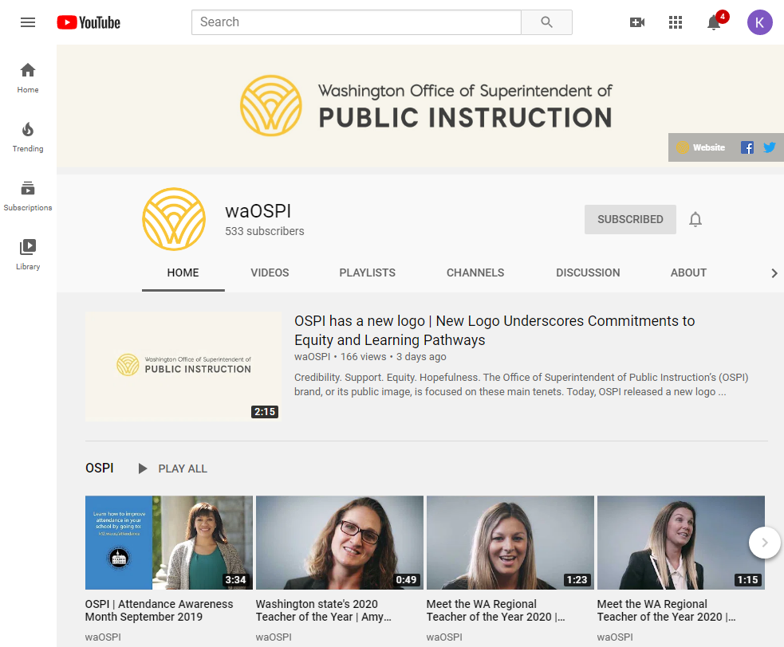
OSPI YouTube Channel
Did you know you can subscribe to the OSPI YouTube Channel?
Watch our past webinars!
Youtube.com/waOSPI
3/11/2020 | 11
Notes:
Did you know our webinars are all posted on our YouTube channel? If you want great ideas from Washington schools you should definitely subscribe!

Slide 12
2019-2020 Professional Learning Theme Calendar
August
Attendance
September
School Climate
October
Behavioral Health
November
9th Grade Success
December
Hope Science
January
College & Career Readiness
February
Language Learners
March
Students With Disabilities
April
High School & Beyond
May
Dual Credit & Multiple Pathways
June
Graduation Equity
3/11/2020 | 12

Slide 13
More This Afternoon
3:00
Students with Disabilities: Implementing and Sustaining Inclusionary Practices: Master Scheduling
3/11/2020 | 13
Notes:
This afternoon we’ll be having a second GATE Equity Webinar – to talk about Designing Research Based Programs.
So come back this afternoon for that!

Slide 14
Next Month
April 8, 2019
High School & Beyond Plans 101:
Increasing Engagement with High School & Beyond Planning
10 a.m. – 11 a.m.
High School & Beyond Plans 201:
Aligning High School & Beyond Plans with IEP Transition Plans
3 p.m. – 4 p.m.
3/11/2020 | 14
Notes:
Next month we’re going to be talking about Increasing Engagement with High School & Beyond Planning and Aligning High School & Beyond Plans with IEP Transition Plans.
These links will be in the chat if you want to register now. Please share this link with friends who may be interested!

Slide 15
MTSS PLC Webinar Series
March 6
Mark McKechnie
Using disaggregated data to identify and support vulnerable student groups
April 10
May 8
Rhonda Nese
Providing alternatives to exclusion
Devon Minch
Engaging Families in MTSS
3/11/2020 | 15
Notes:
We have a sister webinar series, the MTSS PLC Webinar Series. They have a great line up of presenters and topics! This webinar would be useful for any school that wants to think more deeply about MTSS implementation. It was created to support early MTSS adopters in Washington and provides a great place to network and learn from other schools as well as nationally recognized experts in MTSS, we are linking to their bios, If you grab the slides. I know I’ll be there to soak up some knowledge, and hope you check it out too! 11-noon, usually second Friday of the month

Slide 16
Objectives
Understand systems level approach for implementing & sustaining inclusionary practices
Learn from a school how they are implementing these supports
Get resources to get started!
3/11/2020 | 16

Slide 17
Who Are We?
Kefi Andersen
Graduation Equity Program Supervisor
OSPI
Paula Kitzke
Program Review Supervisor
OSPI
Christina Reeves
Teacher
RA Long
Longview School District
Lacey Griffiths
Assistant Principal
RA Long
Longview School District
Nick French
Director of Teaching & Learning, Special Services
Ocosta School District
Karen Abel
Special Education Para-educator
RA Long
Longview School District
3/11/2020 | 17
Notes:
I’m joined today by Veronica Gallardo, OSPI’s Director of Migrant and Bilingual Services.
And she’s brought with her ESD 105’s …
Thanks for all the work you’ve done to share your experiences with our audience!

Slide 18
Questions & Polling 1
Who’s here?
Administrator
Counselor
Teacher
Parent
ESD
District
Continuous Improvement Partner or Coach
Grad Specialist
Community Based Organization
Paraprofessional
Other
Has your school been identified for Comprehensive or Targeted Supports by OSPI?
Yes
No
Not Sure
How familiar are you with our topic?
Very
Somewhat
It’s new!
3/11/2020 | 18
Notes:
We like to get to know our audience so that we can tailor our content to your needs.

Slide 19
Why We Should Focus on Implementing & Sustaining Inclusionary Practices
Notes:
During today’s webinar we will focus on implementing and sustaining inclusionary practices. Inclusion is realized when all students, regardless of their designation to receive special education services, are provided with targeted interventions and accommodations; allowing them to learn in the general education classroom and engage the core curriculum. Inclusion is the belief that all students have a right to meaningfully participate in the general education setting, both academically and socially. Inclusive instruction rebukes the problematic perspective that students receiving special education services need to ‘fit in’ or ‘earn their way’ into general education classes. The belief that general education instruction is not malleable and that students should be making adaptations to be included in the general education setting has contributed to the continuation of two parallel systems of education in which students receiving special education services are marginalized and devalued as a result of their environmental segregation.

Slide 20
OSPI Priorities:
OSPI Priorities:
Improving Outcomes for Students
with Disabilities
Growth Mindset
Increased expectations of
students with disabilities
(e.g., standards, instruction,
graduation, assessments,
attendance, IEP-related
Decisions, and post-school outcomes).
Professional Development
Joint training for general
educators, special educators,
paraeducators, administrators,
and parents/families (e.g., IEP
team members).
Recruitment & Retention
Preparation programs for administrators, general educators, special educators, related service providers, and paraeducators focused around instruction and support for students with disabilities.
Leadership
Support students with disabilities (including increased collaboration and ownership of school administrators and staff) and coordinated efforts with community organizations to improve results and reduce disproportionality.
Evidence-Based Practices
Instruction and interventions
within an MTSS framework and inclusionary practices
leading to increased access
and progress in Washington
grade-level learning standards.
Resource Allocation
Braided funding, consolidated grant application, reducing costs for administrative tasks, increasing direct support to students, and data-based decision making.
Notes:
Why do we as a state and as school counselors need to think differently about how we serve SWD?

Slide 21
Inclusionary Practices Implementation
In 2019, the legislature passed ESHB 1109:
$25M for inclusionary professional development ($10M for 2019-20; $15M for 2020-21)
To implement & support inclusionary practices, with an emphasis on coaching and mentoring for public school teachers
Data-informed decision making Project Implementation webpage

Slide 22
Statewide Trends from Washington Report Card & the Healthy Youth Survey
9th Grade SWDs On-track 59%
68% of SWDs are engaged in education, training or employment
Graduation Rate SWDs 62%
58% of SWDs spend 80-100% of the day in the general education classroom
62%
SWD Graduated in 4 years Class of 2019
*OSPI Report Card , Center for Change in Transition Services, Seattle University, 2019, Nov 2019 Federal Special Education Child Count
3/11/2020 | 22
Notes:
Research consistently supports a positive link between access to instruction in general education settings and improved outcomes for students. Research (& our student demographics!) also show 85-90% of students with disabilities can progress in grade-level curriculum with appropriate supports. Washington State is in the lowest quintile for inclusion nationwide, with 58% of students with disabilities included in general education settings for 80–100% of the school day. Extensive research on the efficacy of inclusion shows that inclusionary teaching yields significant improvements in student academic performance (in all subjects) and improvements in social and emotional outcomes as compared to teaching in separate settings. Inclusionary practices have been shown to reduce behavioral infractions, student absences, and referrals to special education. In inclusive schools, students not only have access to the general education curriculum but they also receive the supports they need to participate in this instruction and to be successful.
Reference data…
The data bolsters a sense of urgency to commit to a culture of equity through implementation of inclusionary practices.

Slide 23
Systems Level Supports for Inclusionary Practices
Visionary Leadership
Collaboration
Restructured Best Practices
Response to Diversity
Redefined Roles
3/11/2020 | 23
Notes:
Restructured Best Practices: Inclusive education is most easily introduced in school communities that have already restructured to meet the needs of their increasingly diverse student populations in regular education. Initiatives and organizational best practices to accomplish this aim include trans-disciplinary teaming, block scheduling, multi-age student grouping and looping, school wide positive behavior support and discipline approaches, de-tracking, and school-within-a-school family configurations of students and teachers, RtI. And MTSS. These initiatives facilitate the inclusion and development of students with disabilities within general education.
School leaders should clearly communicate to educators and families that best practices to facilitate inclusion are identical to best practices for educating all students. This message will help members of the school community understand that inclusion is not an add-on, but a natural extension of promising research-based education practices that positively affect the teaching and learning of all students.
Making Inclusive Education Work Richard A. Villa and Jacqueline S. Thousand.
Visionary Leadership: Changing the culture and educational practices is complex and the extent as to how much may accomplished at a school is dependent on the school’s leader. There must be ongoing attention to consensus building of an inclusive vison. Principals may begin conversations by presenting current school data to confirm or support a need for school change.
Questions for school leaders may include: How can school leaders prepare for the changes required to create inclusive school environments? How can school leaders implement changes that result in inclusive school environments? How can school leaders sustain the positive efforts toward creating inclusive school environments?
Re-defined Roles: School personnel must shift their thinking and actions from an isolated lens (delivering instruction to “my students vs. your students”) to one of shared collaboration and responsibility. Schools should provide ongoing training through opportunities such as course work, professional support groups, in-services, and coaching/ mentoring collaboration to assist educators transitioning to an all inclusive role. In their new roles, general educators should also be made aware of their legal responsibilities for meeting the needs of learners with disabilities in the least restrictive environment.
Collaboration: It is clear that no single individual possess the knowledge and skill to support the need of all students in a classroom. Teachers, specialized personnel and families must develop collaborative skills to create and support diversified learning opportunities for students with wide ranges of skills, interests and needs. Interpersonal communication skill building and developing collaborative teaming processes are essential for effective collaboration. Collaboration emerged as the only variable that predicted positive attitudes toward inclusion among general and special educators as well as administrators (Villa et al., 1996).
Responding to Diversity: Consideration of students and their learning styles, teachers differentiate curriculum content, processes and products before delivering instruction. Universal design benefits all students providing opportunities for individual students to use a variety of approaches to access curriculum, make sense of their learning and demonstrate what they have learned.
Systemic support, collaboration, effective classroom practices, and a universal design approach can make inclusive education work so that students with disabilities have the same access to the general education curriculum and to classmates as any other student and the same opportunity for academic, social, and emotional success. (Making Inclusive Education Work Richard A. Villa and Jacqueline S. Thousand)

Slide 24
Big Ideas
Leadership
Teacher PD
Barriers
3/11/2020 | 24
Notes:
Leadership: Principals “can inhibit or inspire school personnel to accept the inclusion of students with disabilities in the general education classroom. Moreover, their attitudes are critical in the design and implementation of programs and practices in their schools. Principals’ attitudes can either promote or discourage the inclusion practices in their schools. )” Source: Vazquez, M. 2010. “Inclusionary Practices: Impact of Administrators’ Beliefs on Placement Decisions.” Unpublished Doctoral dissertation, University of Central Florida, Orlando, Florida.)
Principals need to be provided with professional development opportunities on inclusion. Principals’ understanding of inclusion and how to arrange school systems in ways that promote inclusive efforts of teachers is critical. Trainings should cover how to properly supervise, support, and evaluate teachers on inclusive practices, and how to design school schedules that are conducive to inclusion; allowing time for educators to collaborate with each other, plan inclusive lessons, and evaluate student and faculty performance.
Teacher PD: Professional development is critical to addressing the concerns of general education teachers regarding the viability of inclusion and their ability to teach SWD. Professional development helps all teachers become more familiar with the concept of inclusion and increase their understanding of student disabilities and how they can be accommodated using a MTSS. School districts play a large part in determining what inclusive training opportunities will be afforded to teachers. These trainings can occur during dedicated development days but should also be considered as an ongoing developmental process.
Pre and in-service professional development for teachers on inclusionary practices are essential to successfully implement and sustain functional inclusion.
Barriers: The best plan for the implementation of inclusionary practices A plan for the implementation of inclusionary practices for effective outcomes for SWD must recognize common institutional and organizational barriers to inclusion.
Low expectations
Lack of access and opportunity to core instruction from content experts
School schedules contribute to removals from core instruction in general education
Teacher and ESA shortages
Staffing models that encourage segregation
Disproportionate discipline
Absence of identified training needs for school staff & educators who support them

Slide 25
High Leverage Support Examples
Universal
UDL
MTSS
Targeted
PD
Personalized
Closing the Gap
Explicit Instruction
Learning Environment
3/11/2020 | 25
Notes:
Universal Design for Learning – UDL is a set of principles that were born from the desire to offer every student an equal opportunity to learn, based on the idea that every person has their own unique and individual learning style According to the National Center on Universal Design for Learning, “UDL provides a blueprint for creating instructional goals, methods, materials, and assessments that work for everyone — not a single, one-size-fits-all solution but rather flexible approaches that can be customized and adjusted for individual needs.”
Multi Tiered System of Support-MTSS takes a proactive approach to identifying students with academic or behavioral needs. Early assessment and intervention for these students can help them catch up with their peers sooner. The key components of MTSS include:
Universal screening of all students early in the school year
Tiers of interventions that can be amplified in response to levels of need
Ongoing data collection and continual assessment
School-wide approach to expectations and supports
Parent involvement
The integrated instruction model of MTSS uses collected data to assess student needs and provide them with interventions in appropriate tiers.
PD – Identify professional development opportunities for administrators, instructional staff and other school personnel and families. Include opportunities for shared leadership development. Successful personalized learning requires prepared and supported educators. Know the strengths and needs of educators and provide continued professional development and support so educators can better meet the needs of all students.
Learning Environment – Provide a supportive school environment – positive school climate is the leading indicator for such outcomes as increased academic achievement, increased teacher retention and reduced discipline referrals. Provide opportunities to level the playing field in developing and sharing knowledge. A means to address the social inequities made possible by and compounded by knowledge inequity. In other words, ‘knowledge equity’ looks at tools and vehicles that can be personalized for the individual learner
Closing the Gap - Identify tools and vehicles that can be personalized for the individual learner. Provide a system of supports (curriculum, training, and technology) with the goal of making general education classrooms more accessible to special populations, and in the process, improving instruction and learning outcomes for all students

Slide 26
Inclusionary Practices

Slide 27
What Advice Would You Give To Schools Starting This Work?
Leaders
Share Responsibility for Leadership
Model School-Wide Commitment
Educators
High Expectations for All Students
Create Collaborative Culture
Partners
Build Professional Community
Embrace Parent Leadership and Support
3/11/2020 | 27
Notes:
Self- Assess for readiness /awareness of inclusion implementation practices
Provide samples

Slide 28
Questions & Polling 2
Has the leadership team at your school had a conversation about inclusion?
Yes! We’re working on it
I’m not sure
Not yet
3/11/2020 | 28

Slide 29
What Does it Look Like in Real Life? A School Perspective RA Long: Longview School District

Slide 30
Who I Am & RA Long’s Context
Lacey Griffiths
Teacher
Team taught with a special education teacher
Special Education Administrator
8th year at RA Long

Slide 31
Fun Facts About R.A. Long
Gone from 60% grad rate to 95% over the past 11 years
Multiple years of Washington State School of Distinction
95% on OSPI Special Education audit this year.
3/11/2020 | 31

Slide 32
Why did you start looking at inclusionary practices?
Data
Who was affected
How our staff responded
3/11/2020 | 32
Notes:
Inclusion is a mindset, not a program. All teachers have to shift their mindset that these are all of our kids, not Special Education students, but gen ed students that need additional supports. When I first started at RA Long, we saw a great amount of behaviors out of our students in the self contained BD classroom. In October of my first year, we did classroom changes and began the process of inclusion. At this point, we don’t have a single self-contained student at RA Long. This becomes a mindset of the entire staff. We do PD around differentiated practices, put paras in classrooms to support the students and teacher, and streamline systems to assist teachers in keeping track of student accom/modifications. We had a solid foundational staff at RA Long and we have hired on staff whose ideologies align with ours.

Slide 33
Strategies for Schoolwide Inclusion
Paras
Staff PD
Mindset
3/11/2020 | 33
Notes:
PARAS
Para PLC: Each week I give the paras a D and F list of students with IEPs. On Wednesdays, we look at the list and decide who will work with which students during Friday Advisory time to get small group instruction/attention.
Paras receive all trainings that staff does during PLC.
STAFF TRAINING:
Beginning of the year, we have a Special Education training that includes understanding lingo, processes, accommodations, modifications, etc.
Providing the information that staff will need in order to daily support students
Common Language and strategies (AVID) in order for students to move between classrooms with predictability which sets them up for success. Even our LifeSkills classrooms use Interactive Notebooks, C-Notes, etc.

Slide 34
Information at Your Fingertips

Slide 35
Brochure Given to Staff During Training
Who’s Who Case Managers
Acronyms
Things to Think About & Reminders
3/11/2020 | 35

Slide 36
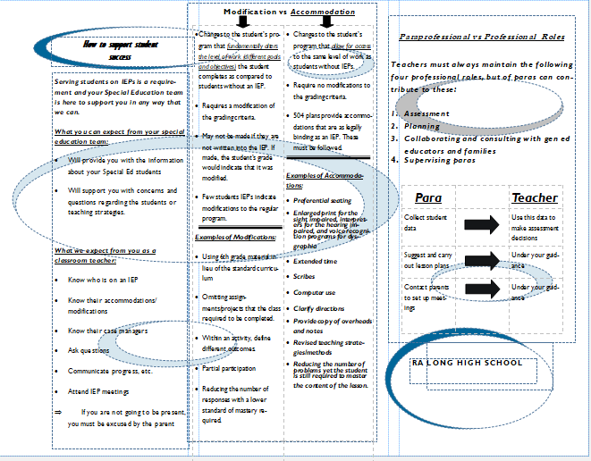
Staff Brochure
How to Support Student Success
What you can expect from your special education team
What we expect from you as a classroom teacher
Modification vs. Accommodation
Paraprofessional vs. Professional Roles

Slide 37
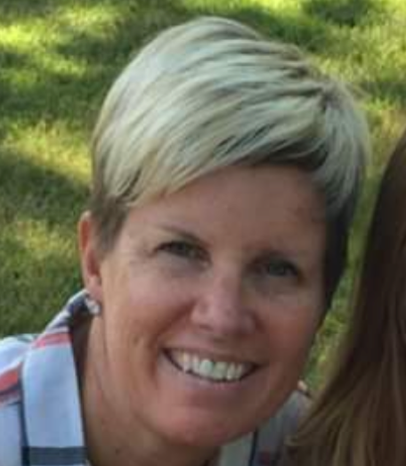
Hearing from a Teacher: Christina Reeves
Results
Delivery of Instruction
How to Accommodate & Modify
Use of Paras & Special Ed Staff
Notes:
Introduce yourself
What does inclusion look like in the classroom?
How do you prepare a lesson that differentiates instruction?
What supports does the administration provided to assist in inclusion?
What supports does the special education staff provide to assist in inclusion?

Slide 38
Hearing from a Para: Karen Abel
Results
Delivery of Instruction
How to Accommodate and Modify
Supporting an Inclusion Classroom
Notes:
Introduce yourself
What does inclusion look like in the classroom?
How do you assist with the preparation of a lesson that differentiates instruction?
What supports does the administration provided to assist in inclusion?
What supports does the special education staff provide to assist in inclusion?

Slide 39
Key Strategies & Interventions
Monitoring
Believe in the students until they believe in themselves
Weekly Para PLC
Weekly Advisory
Transition Services for All with a Job Coach and Curriculum
Systems for Information Flow
Run Weekly D & F lists
Google Surveys by Goal Area
Weekly Student Support Team Meetings
Supports
Not an opportunity gap, but an expectation gap. Hold high expectations
AVID

Slide 40
Our Supports for Students with Disabilities
Universal
AVID Strategies
Professional Development
Targeted
Advisory
Transition Fair
Personalized
Transition
Basic Community Living Curriculum
RA Long University
Summer Work Program
Team Teaching
Master Schedule
Para Support
Hot Passes
Decision Making
Academic Skill Building Class
Jacks’ House
Jack Academy
Copies of Materials
Accommodations & Modifications
Accommodations & Modifications
3/11/2020 | 40

Slide 41
Process For Building A System
How do you know the work will continue after you leave your building?
Customization
Mindset
Systematic
3/11/2020 | 41
Notes:
Customization: Classes, supports, etc. have to be fluid in order to truly support students. This includes the master schedule which looks different every year in order to run what students need.
Rich

Slide 42
Process for Building Teacher Buy-In
Hiring
Targeted PD
Encouraging Risk-taking
100% AVID trained staff
Offering and providing continuous support
Gentle Pressure, Relentless Applied

Slide 43
What Advice Would You Give To People Starting This Work?
Change the Mindset
Do mindset work around ability
Gen Ed kids first
Train & Support All
Common Language & Strategies
Continued supportive PD
Gentle Pressure, Relentlessly Applied
Continued quest for greatness
Hiring staff that have aligned thinking
3/11/2020 | 43
Notes:
Positive relationships and connections
Create a growth mindset
Relevance rigor reflection
Meet needs of each student
Caring teachers – have to care that each student makes it
2016 achievement index top 5% - it’s not about not failing it’s about high rigor
Lots of College in the High School

Slide 44
Questions & Polling 2
In your teacher preparation or leadership programs how were you prepared to work with students with disabilities in an inclusive classroom?
Tell us in the chat
What program were you in?
3/11/2020 | 44

Slide 45
What Does it Look Like in Real Life? A District Office Administrator’s Point of View Nick French Director of Teaching & Learning, Special Services Ocosta School District

Slide 46
Who Am I? Where Am I From? Nick
Nick French
My District
My Past Experience
Work experience
Para/Teacher – Private Placement EBD
K-8 Charter School Resource Teacher
Low Incident Sped Teacher
Special Education Principal
Special Education Supervisor
Director of Student Services
Director of Curriculum & Assessment
Director of Teaching & Learning, Special Services
3/11/2020 | 46

Slide 47
Why Did You Start Looking at Inclusionary Practices?
As a Teacher
As an Administrator
How did Others Respond?
3/11/2020 | 47

Slide 48
Root Causes: What did you find? Admin
Results
BIAS
Fear of the Unknown
Misconceptions
3/11/2020 | 48

Slide 49
What Were Some Themes You Noticed? Admin
Emotional
3 Months
Magic of Special Education
More People is not always the answer
Sped Unwillingness to Change
Building Admin Most Important
3/11/2020 | 49
Notes:
What root causes did you find? How did you address those?
What were some Themes you found for why students were absent?(team, intervention, system)
Root cause – kids with Fs aren’t involved, they’re isolated, mentor helps them with life too. The relationship helps them deal with their traumatic effects
RN/ 3 visitng counselors 1 day a week – seen right there at school
SAGE domestic violence agency comes once a week
Local agency 1 a week for mental health counseling
Drug alcohol counseling
School counselors setup a visiting office for them to use
1st period freshmen rotate classes health, food/nutrition, comp programming (TEALS), intro to technology wood class CTE gives them a well rounded education and gives them a hands on success rate – high engagement in a block (85 minute period)
Absenteeism? Well below the state average in district. 3% lower than the state 2015-2016
Get student services department. No punishment, family community liaisons do home visits, get away from punishment. Spanish speaking. Resource officer goes to pick up kids we think are AWOL
Let out 5 early for lunch – kids with fewest tardies
Ice cream social for them in advisory classes
Attendance takes a team effort

Slide 50
Key Strategies and Interventions
Treat Inclusion as a Cognitive Behavior
Use Common Language and Visuals
Inform All Admins Attitudes Toward Special Educations Continuum of Services Requirement
Proactively Collaborate with Building Admin
Be Staff’s Cheerleader
Model the Work when Needed
While Supporting Teachers, Keep Focus On Student Learning
Find Teacher Leaders
Manage Expectations
Expect Growth in the Program and Student Outcomes
3/11/2020 | 50

Slide 51
Process For Building A System
How did the work spread in your district?
How do you know the work will continue after you leave your building?
Create Language
Create Replacement Processes to Support New Behaviors
Provide Specialized Training While Building Internal Capacity
Celebrate Staff’s Success
Policy, Budgeting, Evaluation Process, District/Building/Team Plans, Reports to staff, School Board, and Community

Slide 52
What Advice Would You Give To People Starting This Work?
Urgency
Start Tomorrow –Individual kid(s), classrooms, grades, or schools
Moral Imperative/Nonnegotiable
People
Identify Early Wins via existing relationships
Identify Leaders – District, Building, Teachers, Paras
Systems
Use Tools to support new behaviors
Provide Specialized Training, at some point
Support Teams
Celebrate the Work
Remove barriers in policy and practices
Notes:
Positive relationships and connections
Create a growth mindset
Relevance rigor reflection
Meet needs of each student
Caring teachers – have to care that each student makes it
2016 achievement index top 5% - it’s not about not failing it’s about high rigor
Lots of College in the High School

Slide 53
Helpful Books
3/11/2020 | 53

Slide 54
GATE Evaluation
This presentation will change my practice in the future:
Definitely
Probably
Not Sure
No – not helpful
This presentation was well organized with a variety of participant involvement:
Strongly agree
Agree
Disagree
Strongly Disagree
The presenters were content experts:
Strongly agree
Agree
Disagree
Strongly Disagree
The presentation met the stated learning objectives:
Strongly agree
Agree
Disagree
Strongly Disagree
GATE Feedback Survey
3/11/2020 | 54
Notes:
We would like to get more information from our audience about our webinars, so we’re going to try something new this month and run our evaluation as a poll.
Thank you for letting us know what you think! If something comes to you later, you also always have the option to share your thoughts through our web evaluation, which is linked on our webinar reminders.

Slide 55
Resources

Slide 56
Resources
Funding
OSPI Unlocking Federal and State Program Funds to Support Student Success
Tools & Videos
About Inclusion
Creating an Inclusive Environment : A model for school Leaders
Websites
IRIS Center– Creating an Inclusive School Environment: A Model for School Leaders
May 20 – WASA/AWSP/WSSDA Equity Conference
Events
NCD – Segregation and SWD
CAST–The Universal Design for Learning Guidelines
LRE Self-Assessment (adapted from WestEd)
Trainer: Elise Brente, Visions for Learning LLC
3/11/2020 | 56

Slide 57
Contact Us
Kefi Andersen
Graduation Equity Program Supervisor
OSPI
Kefi.andersen@k12.wa.us
Paula Kitzke
Program Review Supervisor
OSPI
Paula.kitzke@k12.wa.us
Christina Reeves
Teacher
RA Long
Longview School District
rreeves@longview.k12.wa.us
Lacey Griffiths
Assistant Principal
RA Long
Longview School District
lgriffiths@longview.k12.wa.us
Nick French
Director of Teaching & Learning, Special Services
Ocosta School District
nfrench@ocosta.org
3/11/2020 | 57
Notes:
I’m joined today by Veronica Gallardo, OSPI’s Director of Migrant and Bilingual Services.
And she’s brought with her ESD 105’s …
Thanks for all the work you’ve done to share your experiences with our audience!

Slide 58
Get Personalized Assistance
Do you want personalized support?
We want to help connect you to the right people!
Use the Green Button!
3/11/2020 | 58
Notes:
Another resource we’ve developed is a green button. We want you to be able to contact a real live person to help answer any questions you have. If you want to learn more, connect to a program or get some fresh ideas, we are here for you! Just click on the button and an OSSI staffer will help you get whatever you need.

Slide 60
Creative Commons
Except where otherwise noted, this work by the Office of Superintendent of Public Instruction is licensed under a Creative Commons 4.0 International License.
3/11/2020 | 60

Slide 61
Discussion Questions for the Chat
What are your next leadership moves?
What did you value in the presentation?
What questions do you still have?
What were the big ideas you got from today?
3/11/2020 | 61
Notes:
As we wrap up today, we want to encourage you to take a moment to reflect on the webinar and discuss these questions. You can use the chat, the people around you, or just jot down some thoughts on a sticky note.
What were the big ideas for you?
What are your next leadership moves?
What did you value?
What questions are you still wondering about?
We’ll be here to answer questions for a little while, so take advantage of the opportunity to talk to our presenters with the Q&A. Thank you for joining us for GATE Equity Webinar.
We’ll see you next month as we explore social emotional learning!
<mute>

