Slide 1
Washington Comprehensive Assessment of Science
Test Design & Item Specifications
Grade 5
Science Assessment Development Team
February 4, 2020
Notes:
Hello, and welcome to the Grade 5 Washington Comprehensive Assessment of Science Test Design & Item Specifications training. My name is Dawn Cope, and I am the Science Assessment Lead at OSPI.

Slide 2
Logistics
Webinar Recording, PowerPoint slides and FAQ
https://www.k12.wa.us/student-success/testing/state-testing-overview/washington-comprehensive-assessment-science/wcas-educator-resources
Chat Box
pdEnroller
https://www.pdenroller.org
Notes:
The training is being recorded. The recording will be available on the science assessment website in a few weeks. The final PowerPoint slides, with a script in the notes section, will be posted to the Science Assessment webpage by the end of this week.
All participants have been muted. Please submit questions through the Chat box function in the Zoom Meeting. We will compile questions into an FAQ document that will be posted along with the PowerPoint slides on the science assessment webpage. We will not be using the Hand Raise button today.
Additional details about accessing webinar materials will be given at the end of the presentation.
To receive clock hours, sign in to pdEnroller, create an account, if needed, and register for the webinar. If you have not already registered for the webinar in pdEnroller, you can still do so after today’s presentation. You will need to complete a short evaluation of the webinar to receive the clock hours.

Slide 5
Objectives
This presentation contains a script in the notes section. If you are accessing this information with a screen reader, be sure you are reading the notes section as well as the text contained in the slides.
Share the design and development of the Grade 5 WCAS
Share how Grade 5 WCAS items are aligned to and assess the 2013 Washington State K-12 Science Learning Standards which are the Next Generation Science Standards, or NGSS.
Notes:
The objectives of this presentation are to:
Share how the Grade 5 WCAS is designed and developed.
Share how Grade 5 WCAS items are written to assess the 2013 Washington State K-12 Science Learning Standards which are the Next Generation Science Standards, or NGSS.
The information we are going to share is found in a document called the Grade 5 WCAS Test Design and Item Specifications. The most recent version of the Test Design & Item Specifications document was published in August 2019. This version included item specifications for all 45 PEs.
The OSPI Science Team wants to acknowledge and extend a big THANK YOU to all of the Washington State educators who contributed to the development of the item specifications.
The Test Design and Item Specifications document is always in draft form. We make slight modifications throughout the year as we receive feedback from educators that participate in assessment development work groups like item writing and content review. An updated document is published each fall, accompanied by a modifications log so you can see the changes that were applied.
Please note that the Test Design and Item Specifications document is not intended to guide classroom instruction, but rather, it describes how item clusters (stimuli and items) and standalone items are developed to assess the Washington State K–12 Science Learning Standards (NGSS) on the state summative test.

Slide 6
Contact Information
Dawn Cope—Science Assessment Lead
  dawn.cope@k12.wa.us
Jacob Parikh—Science Assessment Specialist
  jacob.parikh@k12.wa.us
Korey Peterson—Science Assessment Specialist
  korey.peterson@k12.wa.us
Jessica Cole—Program Specialist
  jessica.cole@k12.wa.us
General e-mail account
  science@k12.wa.us
Notes:
I am joined today by Jacob Parikh and Korey Peterson, state Science Assessment specialists.
Korey and Jacob will be presenting the webinar today, and I will be monitoring the chat box. We will pause about mid-way through and near the end of the presentation to address questions as needed.
This slide provides contact information for the science assessment team. Please do not hesitate to contact us with your questions about this training or any other questions you have about the state science assessment.

Slide 7
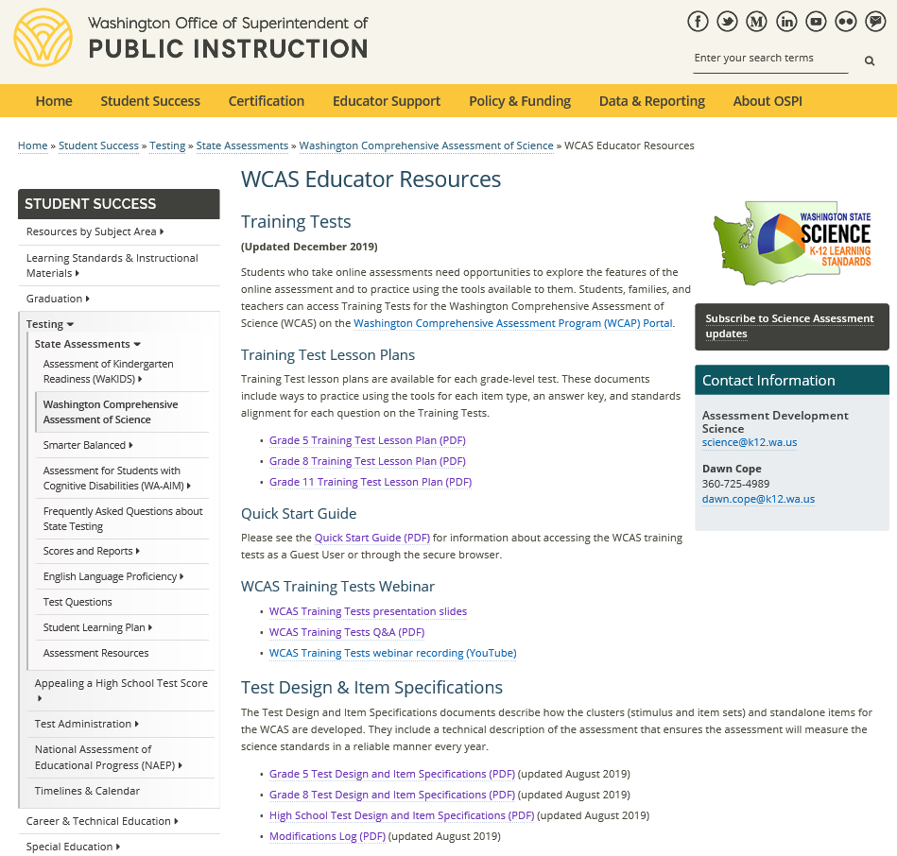
Test Design and Item Specifications-Grade 5
https://www.k12.wa.us/student-success/testing/state-testing-overview/washington-comprehensive-assessment-science/wcas-educator-resources
Notes:
You can find the Grade 5 Test Design and Item Specifications document by going to the WCAS Educator Resources webpage: https://www.k12.wa.us/student-success/testing/state-testing-overview/washington-comprehensive-assessment-science/wcas-educator-resources
There are separate documents for 5th grade, 8th grade, and high school. Many parts of the documents are similar. Key differences occur on the Test Blueprint pages and the Item Specifications sections of the documents.
This training is for the Grade 5 Test Design and Item Specifications document.
[CLICK]
Additional trainings cover the Grade 8 and High School documents.
Those of you who registered for this webinar were sent a PDF of the Grade 5 Test Design and Item Specifications via email yesterday. I am going to pause for one minute so you can access the document in your email or from the Science Assessment Educator Resources page .
We posted a link to the Grade 5 document in the chat.

Slide 8
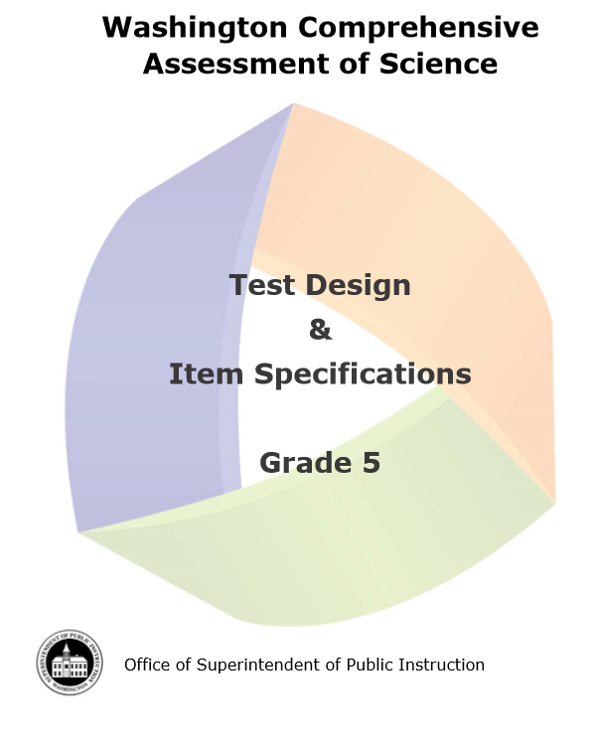
Document Components
Test Design (pages 1-14)
  Development Cycle
  Structure of the Test
  Item Types
  Test Structure
  Standards Overview
  Resources and References
Item Specifications (pages 15-113)
SEP, DCI, and CCC Vocabulary
(pages 114-115)
Notes:
The Test Design section of the document (pages 1-14) is an overview of the test design and development. We will be touching on many components of this section during the presentation. The section has the answers to important and commonly asked questions. We encourage you to become familiar with the information the test design section contains.
The second section of the document contains the item specifications (pages 15 to 113). Item specifications describe how items are written for the WCAS. The section has an item specification for each of the 45 Performance Expectations that could be assessed on a Grade 5 WCAS. For a given year, about 25 to 30% of the Performance Expectations are assessed. This will be explained further when we talk about the test blueprint.
The third section of the document contains a list of vocabulary terms (pages 114-115).
As we move through today’s presentation, relevant page numbers for the Test Design and Item Specifications document will be displayed in purple text boxes.

Slide 9
WCAS Development Process
Educator Involvement
Notes:
Pages 1 and 2 of the Test Design and Item Specifications document give an overview of the WCAS development process.

Slide 10
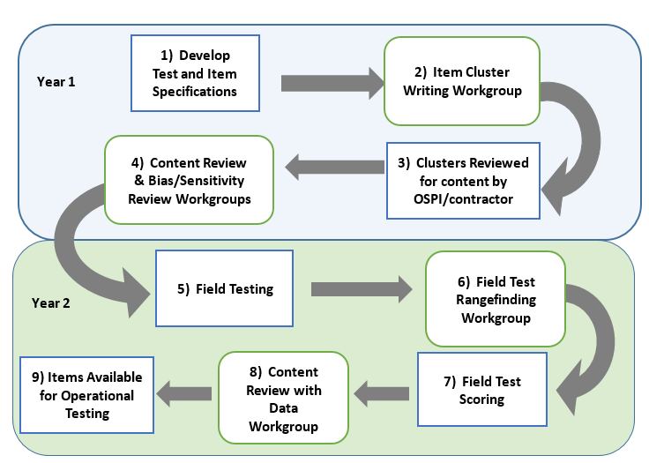
Science
Assessment
Development
Cycle
Pages 1-2
Notes:
Washington educators are heavily involved in this process, which takes place over the course of at least 2 years from when an item is first drafted to when it could possibly be seen by a student and count in their test score.
The Science Assessment Development Cycle graphic is found on page 2.
The first step in the Science Assessment Development Cycle is the development of the Test Design and Item Specifications. The OSPI science team began thinking about Test Design and Item Specifications when the science standards were adopted in 2013 and through each of the development work groups over the past several years. Step 1 occurs during each of the other steps of this process as parts of the Test Design and Item Specifications document is reviewed during each work group.
The second step is the Item Cluster Writing Work Groups. This is where Washington educators work in teams of 2-3 to write stimuli, items, and rubrics for item clusters (a set of stimuli and items), that are designed to measure student understanding of the state standards. The item clusters are then reviewed by the OSPI science team and the development contractors for content, including improvements to the art work (step 3).
In step 4, during Content Review Work Groups, educators review the products of the item cluster writing work group to ensure every stimulus, item, and rubric is scientifically accurate and gathers appropriate evidence about student mastery of the NGSS. At the same time, a separate committee of community members reviews the items and stimuli for any bias and sensitivity issues. Recommendations from the Bias and Sensitivity review are considered by the Content Review work group.
After that the OSPI science team works with the test delivery contractor to put the items and stimuli into the online system for field testing with students (step 5). Students see the Field Test items as part of their operational test, but the items are not counted in a student’s WCAS score.
After student testing is completed, educators meet in Field Test Range Finding Work Groups (step 6) to look at a range of student responses to each short answer field test item and decide how to score the responses. This educator workgroup refines scoring rubrics and produces the materials that will be used to score the short answer field test items. Then, the items are scored by the contractor in step 7. Remember, the field test results do not count toward a student’s WCAS score.
The 8th step in the process is the Content Review with Data Work Group where educators use item performance data (which is a variety of statistics about how students responded to the items), as well as their science content knowledge, to recommend whether each item should advance into the item bank. Educators see data for each item that answers questions like:
How many students answered the item correctly?
Which “wrong” answers were chosen by the most students?
Do students who score high on the test get this item correct?
Did students of a particular gender or ethnicity answer the item differently than the rest of the students?
The OSPI science team use the stimuli and items that have been accepted into the item bank to build the WCAS.
Step 9 takes about 6 months, from the point when the OSPI science team puts a test form together in the fall to when students see the test the following spring.
[PAUSE]
Educators are a critical component of Science Assessment Development, and the OSPI Science team welcomes and encourages your participation.
The OSPI Science Team wants to acknowledge and extend another big THANK YOU to all of the Washington State educators, this time to those who have participated in assessment development work groups and helped the OSPI science team develop every stimulus and item that appears on the WCAS.
10

Slide 11

Join Us!
Science Assessment Professional Development Opportunities
https://www.k12.wa.us/student-success/resources-subject-area/science/science-assessment-professional-development-opportunities
Invitations to apply for work groups are emailed to those signed up for science assessment updates through the science assessment listserv. https://public.govdelivery.com/accounts/WAOSPI/subscriber/new
Notes:
If you are interested in participating in a science assessment development work group, you can find more information on the Science Assessment Professional Development Opportunities webpage. https://www.k12.wa.us/student-success/resources-subject-area/science/science-assessment-professional-development-opportunities
To receive invitations to apply for work groups, as well as receive science assessment updates, be sure to sign up for the science assessment listserv. https://public.govdelivery.com/accounts/WAOSPI/subscriber/new

Slide 12

Washington Standards Overview
NGSS 101
Notes:
Pages 10 through 12 of the Test Design and Item Specifications document describe how the standards are the basic foundation of the design of the WCAS.
The standards that the WCAS tests are the Next Generation Science Standards or NGSS, which were adopted in fall 2013. OSPI re-named the NGSS as the Washington State 2013 K-12 Science Learning Standards.

Slide 13
NGSS 3-5 Band
Pages 10-12
Domains
  Physical Sciences (PS)—17 Performance Expectations
  Life Sciences (LS)—12 Performance Expectations
  Earth and Space Sciences (ESS)—13 Performance Expectations
  Engineering Design (ETS)—3 Performance Expectations
  Each Performance Expectation includes a Science and Engineering Practice (SEP), a Disciplinary Core Idea (DCI), and a Crosscutting Concept (CCC)
Notes:
The structure of the standards is important to understand before diving into the structure of the WCAS. An overview of the standards is provided on pages 10-12 of the Test Design and Item Specifications document.
The 3-5 Band of standards includes 45 Performance Expectations organized into 4 domains:
Physical Sciences
Life Sciences
Earth and Space Sciences
Engineering Design
Each Performance Expectation provides a statement of what students should be able to do by the end of instruction and includes a Science and Engineering Practice, a Disciplinary Core Idea, and a Crosscutting Concept.

Slide 14
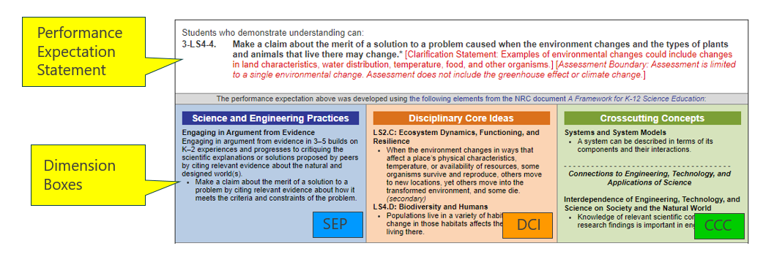
NGSS
Performance
Expectation
Notes:
This slide shows one Performance Expectation, 3-LS4-4. The “3” tells us that this Performance Expectation is from the 3-5 band of standards, the “LS4” refers to the overarching concept of “Biological Evolution: Unity and Diversity,” and the “-4” tells us that it is the fourth in a series of grade 3-5 Performance Expectations about that overarching concept.
The text of the Performance Expectations starts with the Performance Expectation Statement in black font and may be followed by a clarification statement and/or assessment boundary in red font. The clarification statements supply examples or additional clarification to the performance expectations. The assessment boundaries are meant to specify limits to large-scale assessment. They are not meant to put limits on what can be taught or how it is taught, but to provide guidance to assessment developers.
The Performance Expectation statement incorporates three dimensions, shown below in the Dimension Boxes. These include a science and engineering practice (SEP), one or more disciplinary core ideas (DCI), and a crosscutting concept (CCC). The Performance Expectation statement can provide some insight as to how the student is expected to utilize the SEP, DCI, and CCC together to achieve the performance expectation.
We will talk more about this structure when we get to the Item Specifications section of the presentation.

Slide 15
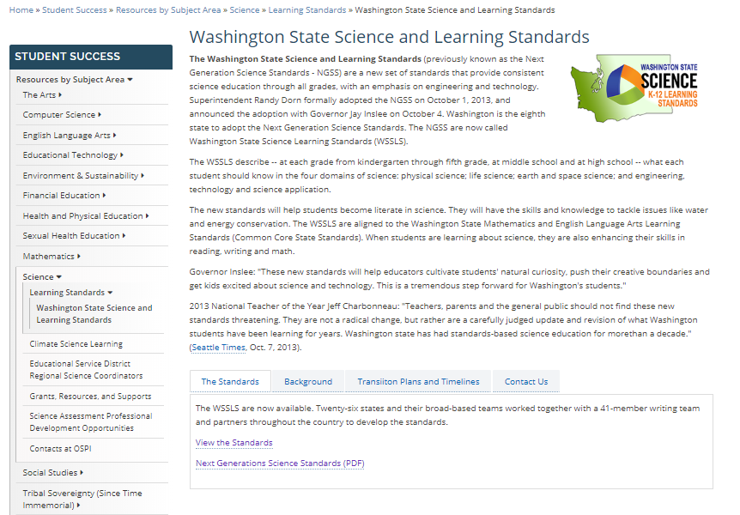
The 2013 Washington State K-12 Science Learning Standards are the Next Generation Science Standards (NGSS)
OSPI Science Standards Webpage
https://www.k12.wa.us/student-success/resources-subject-area/science/science-k%E2%80%9312-learning-standards/washington-state-science-and-learning-standards
Next Generation Science Standards https://www.nextgenscience.org/search-standards
Get to Know the Standards
https://www.nextgenscience.org/get-to-know
Understanding the Standards: https://www.nextgenscience.org/understanding-standards/understanding-standards
Notes:
This slide provides you with a link to the OSPI Science Standards [CLICK] webpage as well as additional NGSS resources.

Slide 16
Test Structure
Notes:
Pages 3-9 of the Test Design and Item Specifications document describe the structure of the WCAS.
The WCAS is composed of item clusters and standalone items that align to the NGSS Performance Expectations. It will take us a few slides to build the full picture of how item clusters and standalone items are carefully put together to compose a test form.

Slide 17
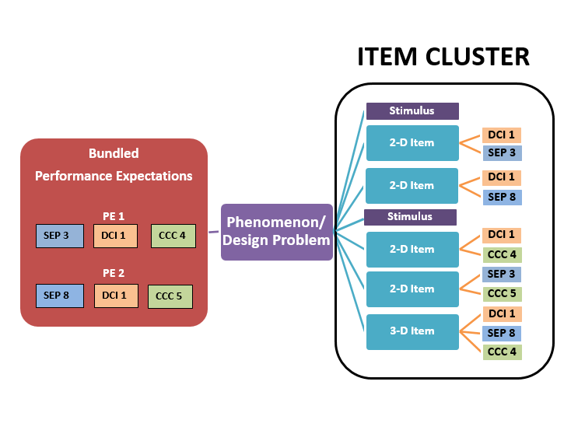
Cluster
Map
Page 3
Notes:
The graphic on this slide models the structure of an item cluster and can be found on page 3 of the Test Design & Item Specifications document.
Let’s start with the phenomenon or design problem that is used to give the cluster coherence.
[CLICK]
The use of phenomena or design problems in item and cluster development provides:
a context in which to demonstrate transfer of knowledge and skills,
a focus for combining knowledge and abilities from multiple dimensions, and
an element of interest and motivation for students.
Next, a Performance Expectation bundle is generally two related Performance Expectations that are used to explain or make sense of a scientific phenomenon or a design problem.
[CLICK]
Performance Expectations may be bundled across domains (for example., Life Science and Earth and Space Science PEs) or may be domain-specific (for example., all Life Science).
Performance Expectations may be bundled that have dimensions in common (for example, all Performance Expectations have the modeling SEP) or bundled to include a range of dimensions (for example, the Performance Expectations have no SEP, DCI, or CCC in common).
Some Performance Expectations may be robust enough to support an entire item cluster on their own, but most bundles will consist of two Performance Expectations. An individual Performance Expectation may be used in more than one bundle, but care will be taken to ensure that no Performance Expectation will be over-represented on a WCAS form.
The item cluster is carefully constructed such that:
[CLICK]
each item is linked to a stimulus or stimuli and to the other items within the item cluster,
each item is aligned to at least two dimensions from the PE bundle,
at least one item is three-dimensional,
all items support the phenomenon or design problem identified, and
the items progress logically and contain internal scaffolding to support the student’s progression to higher levels of complexity.
In addition,
Stimuli are interspersed among the items to add information as needed.
Some items have more than one part (ex: Part A, Part B) in order to achieve 2 or 3-dimensional alignment.
During item cluster development, judgements about alignment to Performance Expectations are made at multiple levels. Each level of alignment judgment contributes to the overall alignment of the cluster. For example, all individual item alignment judgments and judgments on the appropriateness of the phenomenon and the stimulus combine to contribute to the overall judgment of the item cluster as aligned and appropriate for the Performance Expectation bundle.

Slide 18
Standalone Items
Use a single item to address two or three dimensions of one PE
Stimulus and question/questions
Notes:
A standalone item is a focused measurement tool that uses a single item to address two or three dimensions of one Performance Expectation. Standalone items allow for increased Performance Expectation coverage on a given administration of the WCAS. A standalone item includes a stimulus and a question. Standalone items can have more than one part (e.g., Part A, Part B).

Slide 19
Grade 5 Blueprint
Pages 8-9
Reporting Area | Percentage of PEs per Science Domain in the Standards | Percent Range for the WCAS per Science Domain | Score Point Range for WCAS per Science Domain
Practices and Crosscutting Concepts in Physical Sciences | 40% | 35-45% | 12-16
Practices and Crosscutting Concepts in Life Sciences | 29% | 25-35% | 8-12
Practices and Crosscutting Concepts in Earth and Space Sciences | 31% | 25-35% | 9-13
35 Total points
6-12 standalone items
5 clusters
Estimated testing time: 120 minutes
ETS PEs are assessed but not reported separately.
Notes:
The Grade 5 blueprint is found on page 9 of the Test Design and Item Specifications document, and shows how clusters and standalone items are put together for a test.
The number of Performance Expectations in three of the domains (physical sciences, life sciences, and Earth and space sciences) in the 3-5 band of the standards were used to find the percentage of Performance Expectations per domain. See the second column. Approximately 40% of the standards are from the physical sciences domain, 29% of the standards are from the life sciences domain, and 31% of the standards come from the Earth and space sciences domain.
The WCAS will include a similar percentage of items per domain. That is what you see in the third column. The last column takes the 35 total points for the grade 5 WCAS, and breaks them out by those percentages.
A student receives an overall scale score on the WCAS, and a sub-score for each of three reporting areas: practices and crosscutting concepts in physical sciences, practices and crosscutting concepts in life sciences, and practices and crosscutting concepts in Earth and space sciences.
The Engineering Design (ETS) Performance Expectations are always bundled with a Physical Sciences, Life Sciences, or Earth and Space Sciences Performance Expectation for the WCAS, but are not reported in a separate reporting area.

Slide 20
Performance Expectation Coverage
Pages 8-9
Stand Alone items
  6-12 items per operational form
  Each item must assess 2 or 3 dimensions of a single PE
  Increases DCI, SEP, and CCC coverage for the whole test
Item Clusters
  3-6 items per cluster
  5 clusters per operational form
  At least one PE from each domain (PS, LS, ESS, and ETS) represented
  A minimum of 3 different SEPs across the clusters
  A minimum of 3 different CCCs across the clusters
Notes:
As students work their way through the Grade 5 WCAS, they will first encounter 6 to 12 standalone items.
After the standalone items, the test turns to item clusters. There are 3 to 6 items per cluster.
The grade 5 assessment has 5 clusters. There will be at least one cluster on the test that assesses each domain (physical, life, and Earth and space sciences, as well as engineering design). There will be a minimum of 3 different Science and Engineering Practices across the clusters, and a minimum of 3 different Crosscutting Concepts across the clusters.
Approximately 1/4 to 1/3 of the 45 Performance Expectations can be covered on a given year’s WCAS. This means that, with careful planning and test building, all of the grade 5 performance expectations can be assessed over 3-5 administrations.
If it feels like you are starting to put together a 4-D puzzle in your head with all of these requirements….you are on the right track for what test building feels like.

Slide 21
Structure and Administration
Pages 8-9
Structure
  Operational Section
    Counts toward a student’s score
    Fixed form
  Field Test Section
    Embedded in the online administration
    Does not count toward a student’s score
    A cluster or several standalone items
Administration
  Can be administered in multiple sessions like the Smarter Balanced ELA and Math tests
  1 to 3 sessions recommended
Notes:
Remember, there are items field-tested on each years’ WCAS. They are embedded in the online test and do not count toward a student’s score. The field test items are either a cluster of items, or several standalone items. We need students to put forth as much effort into field test items as they do for the operational items to get as accurate information as possible about how the field test items function.
Like the Smarter Balanced tests, the WCAS can be given to students over multiple test sessions. We recommend 3 sessions maximum. Remember, each time a student starts a session, they have to go through the log in procedures that add to total testing time. Information about splitting the test into multiple sessions is included in the Test Administrators Manual available through the WCAP Portal. https://wa.portal.cambiumast.com/

Slide 22
Features & Item Types
Pages 4-7
Features
  Collapsible Stimuli
  Locking items
  Multipart items
  Animation
  Calculator https://www.desmos.com/testing/washington
Item Types
  Multiple Choice
  Multiple Select
  Short Answer
  Drag and Drop
  Hot Text
  Table Match
  Table Input
  Edit Task Inline Choice
  Simulation
Notes:
Pages 4 through 7 of the Test Design and Item Specifications document give details about the features and item types on the WCAS.
Standalone items fill the entire screen.
For an item clusters, stimuli and items are presented side-by-side—with stimuli on the left and items on the right.
For an item cluster that has more than one stimulus, each stimulus is delivered along with the items most closely associated to that stimulus. Once a stimulus is presented, it is available to the student throughout the cluster. To minimize vertical scrolling and the need to move back to previous screens within a cluster, a stimulus is collapsed once the next stimulus is provided. A +/- icon in the heading of a stimulus section allows the stimulus to be hidden from view or expanded to suit a student’s current need.
WCAS clusters include some locking items in which the student cannot change their answer once they have moved on to the next item. A padlock icon next to the item number alerts students that they are answering a locking item. When they start to move on from the item, an “attention” box warns the student that they will not be able to change their answer once they move on. The student can either return to the item or move forward and lock in their answer.
Locking items allow the student to be updated with correct information in subsequent items or stimuli. In addition, locking items help to limit item interaction effects or clueing between items in a cluster.
Students can return and view an item that has been locked. The student will see their answer, but they cannot change their answer.
A basic four-function calculator is embedded in the online platform for all items in the WCAS for grade 5. Students should be familiar with the functionality of the calculator prior to using it on the assessment. The calculator is available online and as an app for practice. For more information about the calculator available during testing, visit the Desmos.com State Assessments webpage https://www.desmos.com/testing/washington

Slide 23
WCAS Training Tests
Grades 5, 8, 11
Accessed through the WCAP Portal
https://wa.portal.cambiumast.com/training-tests.stml
Grade 5 Lesson Plan
https://www.k12.wa.us/sites/default/files/public/science/pubdocs/LessonPlans5-FINAL%20DRAFT.pdf
Grade 8 Lesson Plan
https://www.k12.wa.us/sites/default/files/public/science/pubdocs/LessonPlans8-FINAL%20DRAFT.pdf
Grade 11 Lesson Plan
https://www.k12.wa.us/sites/default/files/public/science/pubdocs/LessonPlans11-FINAL%20DRAFT.pdf
Quick Start
https://www.k12.wa.us/sites/default/files/public/science/pubdocs/OnlineTrainingTestQuickStart-FINAL_DRAFT.pdf
Notes:
The WCAS is delivered online using the same platform as the Smarter Balanced tests and may look familiar to students. However, students who take online assessments need opportunities to explore the features of the online assessment and to practice using the tools available to them.
The WCAS training tests were expanded in December 2019. The training tests are available through the WCAP Portal. https://wa.portal.cambiumast.com/training-tests.stml
The Grade 5 and Grade 8 training tests each have two new standalone items.
The Grade 11 training test has three new standalone items and one new item cluster.
All standalone items and item clusters on the training tests were developed by Washington educators and successfully field tested with Washington students. The standalone items and item clusters were carefully chosen for the training tests to represent a variety of online question types and features. All students can access all three training tests, if desired.
Training Test Lesson Plans for each grade-level training test are available on the WCAS Educator Resources webpage.
https://www.k12.wa.us/student-success/testing/state-testing-overview/washington-comprehensive-assessment-science/wcas-educator-resources
The documents include descriptions of ways to practice using the tools for each item type, an answer key, and information about the standards alignment for each question.
Grade 5 lesson Plan
https://www.k12.wa.us/sites/default/files/public/science/pubdocs/LessonPlans5-FINAL%20DRAFT.pdf
Grade 8 Lesson Plan
https://www.k12.wa.us/sites/default/files/public/science/pubdocs/LessonPlans8-FINAL%20DRAFT.pdf
Grade 11 Lesson Plan
https://www.k12.wa.us/sites/default/files/public/science/pubdocs/LessonPlans11-FINAL%20DRAFT.pdf
A separate Quick Start Guide includes information about accessing the training tests as a guest user or through the secure browser.
Quick Start Guide
https://www.k12.wa.us/sites/default/files/public/science/pubdocs/OnlineTrainingTestQuickStart-FINAL_DRAFT.pdf

Slide 24

Q&A
Notes:
We are going to stop here for a few minutes and answer some questions that have come in.

Slide 25
Item Specifications
Notes:
Now we are going to move into the Item Specifications part of the presentation.
The science assessment team at OSPI worked with Washington State educators and assessment research and development partners to produce item specifications that will support multi-dimensional item development.
The following two slides represent an item specification. We are going to use Performance Expectation 4-ESS3-2 as the example. It can be found on pages 104 and 105 of the Grade 5 Test Design and Item Specifications document.

Slide 26
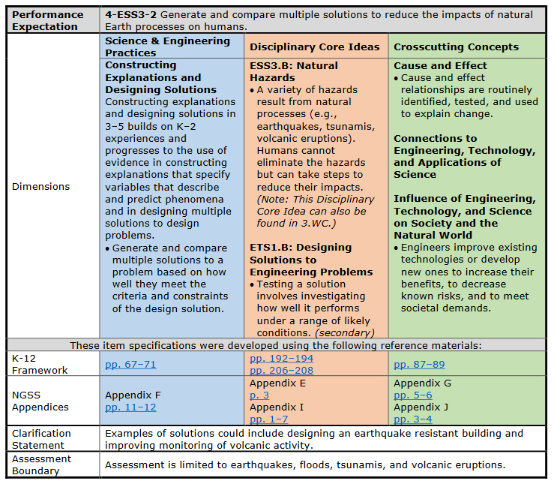
4-ESS3-2
Pages 104-105
Front Page
Notes:
The Item Specification is two pages.
Most of the front page is language copied from the NGSS.
For example, the Performance Expectation statement [CLICK]
And the dimensions information
the SEP in blue [CLICK],
the DCI in orange [CLICK], and
the CCC in green [CLICK]
Come directly from the Performance Expectation.
While the performance expectations can stand alone, a more coherent and complete view of what students should be able to do comes when the performance expectations are viewed in tandem with the contents of the dimensions boxes.
Let’s read these four pieces together to see how this works.
4-ESS3-2 Generate and compare multiple solutions to reduce the impacts of natural Earth processes on humans.
Science & Engineering Practices: Constructing Explanations and Designing Solutions
Constructing explanations and designing solutions in 3–5 builds on K–2 experiences and progresses to the use of evidence in constructing explanations that specify variables that describe and predict phenomena and in designing multiple solutions to design problems.
Generate and compare multiple solutions to a problem based on how well they meet the criteria and constraints of the design solution.
Disciplinary Core Ideas:
ESS3.B: Natural Hazards
A variety of hazards result from natural processes (e.g., earthquakes, tsunamis, volcanic eruptions). Humans cannot eliminate the hazards but can take steps to reduce their impacts.
ETS1.B: Designing Solutions to Engineering Problems
Testing a solution involves investigating how well it performs under a range of likely conditions.
Crosscutting Concepts:
Cause and Effect
Cause and effect relationships are routinely identified, tested, and used to explain change.
Influence of Engineering,
Technology, and Science on Society and the Natural World
Engineers improve existing technologies or develop new ones to increase their benefits, to decrease known risks, and to meet societal demands.
Next, you’ll find links to the exact pages in the K-12 Framework for Science Education [CLICK] and the NGSS Appendices [CLICK] where more information about each dimension can be found.
The K-12 Framework for Science Education is the foundational document for the NGSS. It is grounded in the most current research on science and science learning and identifies the science all K–12 students should know upon completion of high school. https://www.nap.edu/catalog/13165/a-framework-for-k-12-science-education-practices-crosscutting-concepts
The NGSS Appendices provide background and detail about the standards. https://www.nextgenscience.org/resources/ngss-appendices
We won’t explore these links today, but this feature of the item specifications provides a quick way to access this helpful information.
Finally, the front page lists the clarification statement [CLICK] and assessment boundary [CLICK] which also include language directly from the Performance Expectation.
For this Performance Expectation, these statements tell us that the “Examples of solutions could include designing an earthquake resistant building and improving monitoring of volcanic activity.” and that “Assessment is limited to earthquakes, floods, tsunamis, and volcanic eruptions.”

Slide 27
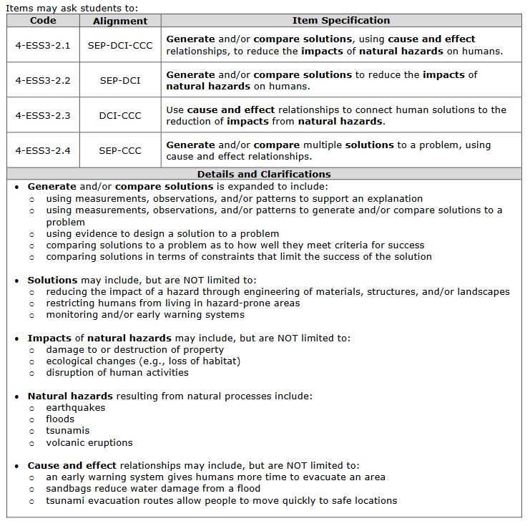
4-ESS3-2
Pages 104-105
Back
Page
Notes:
The back page is specific to the WCAS and always starts with a table of four Item Specifications [CLICK].
The first item specification has a code with a “.1” added onto the end of the Performance Expectation number. The code for the first item specification here is 4-ESS3-2.1 The first item specification describes how a three dimensional item is written to assess the SEP, DCI, and CCC of the Performance Expectation.
The second item specification listed--has a code with a “.2” added onto the end of the Performance Expectation number. The second item specification describes how a two dimensional item is written to assess the SEP and DCI of the Performance Expectation.
The third item specification listed--has a code with a “.3” added onto the end of the Performance Expectation number. The third item specification describes how a two dimensional item is written to assess the DCI and CCC of the Performance Expectation.
The fourth item specification listed--has a code with a “.4” added onto the end of the Performance Expectation number. The fourth item specification describes how a two dimensional item is written to assess the SEP and CCC for the Performance Expectation.
When you read each of the four specifications, you’ll notice key words bolded.
The “Details and Clarifications” section [CLICK] includes information that helps unpack those key words.
It is important to note that the details and clarifications section provides EXAMPLES only, NOT exhaustive lists.
If I want to write a three dimensional item, I would use item specification 4-ESS3-2.1 as a guide, and then use the details and clarifications section to help put the pieces together. The other three item specifications would guide the development of two-dimensional items.
I can see from the first set of bullets in the details and clarifications section that there are several ways to assess the “Constructing Explanations and Designing Solutions” SEP. For example, I could write an item in which students are:
using measurements, observations, and/or patterns to support an explanation
using measurements, observations, and/or patterns to generate and/or compare solutions to a problem
using evidence to design a solution to a problem
comparing solutions to a problem as to how well they meet criteria for success
comparing solutions in terms of constraints that limit the success of the solution
I am not limited to “Generate and compare multiple solutions to a problem based on how well they meet the criteria and constraints of the design solution.” like the blue box on the front page indicated.
The second set of bullets gives some examples of solutions to a problem, like:
reducing the impact of a hazard through engineering of materials, structures, and/or landscapes
restricting humans from living in hazard-prone areas
monitoring and/or early warning systems
The third set of bullets gives some examples of the impacts of natural hazards on humans, like:
damage to or destruction of property
ecological changes (e.g., loss of habitat)
disruption of human activities
The fourth set of bullets lists the natural hazards resulting from natural processes that can be assessed including:
earthquakes
floods
tsunamis
volcanic eruptions
The fifth set of bullets gives examples of cause and effect relationships that could be assessed, like:
an early warning system gives humans more time to evacuate an area
sandbags reduce water damage from a flood
tsunami evacuation routes allow people to move quickly to safe locations

Slide 28
Item Specifications Activity
Notes:
Now we are going to use the Soggy Solutions cluster found in the Grade 5 WCAS Training Test to connect the item specification we just looked at to item development for the WCAS.
Please note that for of this next part of the presentation, even though the cluster is available online in the Grade 5 WCAS training test, we are not going to look at the cluster in the online platform. Instead, the science team has come up with a way to show alignment between the items and the performance expectation bundle using static images.

Slide 29
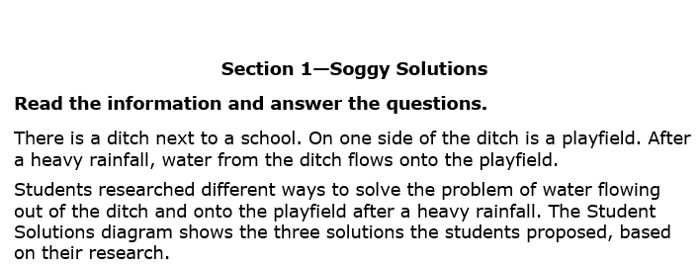
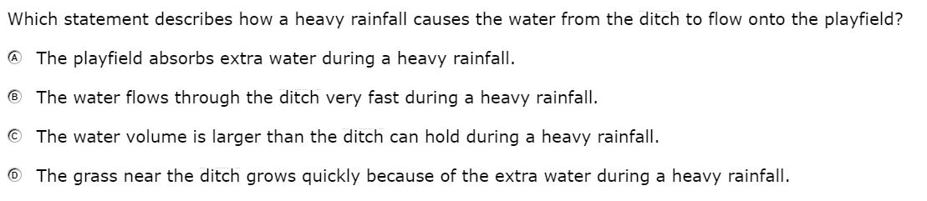
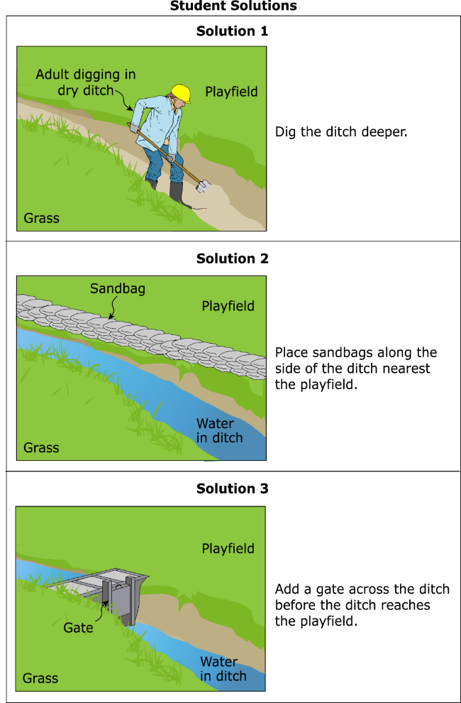
Item 1
Notes:
This is the first stimulus section for Soggy Solutions.
It reads:
“Section 1—Soggy Solutions. Read the information and answer the questions. There is a ditch next to a school. On one side of the ditch is a playfield. After a heavy rainfall, water from the ditch flows onto the playfield. Students researched different ways to solve the problem of water flowing out of the ditch and onto the playfield after a heavy rainfall.
The Student Solutions diagram shows the three solutions the students proposed, based on their research. “Solution 1. Dig the ditch deeper. Solution 2. Place sandbags along the side of the ditch nearest the playfield. Solution 3. Add a gate across the ditch before the ditch reaches the playfield. “
The first item for the Soggy Solutions cluster reads:
“Which statement describes how a heavy rainfall causes the water from the ditch to flow onto the playfield? “
A The playfield absorbs extra water during a heavy rainfall.
B The water flows through the ditch very fast during a heavy rainfall.
C The water volume is larger than the ditch can hold during a heavy rainfall.
D The grass near the ditch grows quickly because of the extra water during a heavy rainfall.

Slide 30
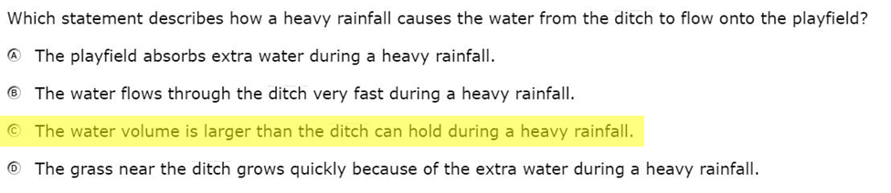
Item 1
Notes:
Here is the correct answer for item 1.
This item was developed to align to 4-ESS3-2, the Performance Expectation we just looked at. The next question is—Which item specification does the item align to: 4-ESS3-2.1, 4-ESS3-2.2, 4-ESS3-2.3, or 4-ESS3-2.4?

Slide 31
Item 1
Notes:
Here is the set of item specifications and details and clarifications again for 4-ESS3-2.
Thinking about what students are asked to demonstrate in item 1, which specification does this item most closely align to?
If they are being asked to “Generate and/or compare solutions, using cause and effect relationships, to reduce the impacts of natural hazards on humans.” then this is a three-dimensional item aligned to 4-ESS3-2.1.
If they are being asked to “Generate and/or compare solutions to reduce the impacts of natural hazards on humans.“ then this is a two-dimensional item aligned to 4-ESS3-2.2.
If they are being asked to “Use cause and effect relationships to connect human solutions to the reduction of impacts from natural hazards.” then this is a two-dimensional item aligned to 4-ESS3-2.3.
If they are being asked to “Generate and/or compare multiple solutions to a problem, using cause and effect relationships.” then this is a two-dimensional item aligned to 4-ESS3-2.4.
During the development of this item, educator work groups determined that this is a two-dimensional item aligned to 4-ESS3-2.3. Students are asked to apply knowledge of a cause and effect relationship (the CCC) between a heavy rainfall and the flooding (the DCI) of the playfield. The item is not aligned to the SEP as students are not asked to demonstrate any of the bullets listed for the SEP in the Details and Clarifications section.

Slide 32
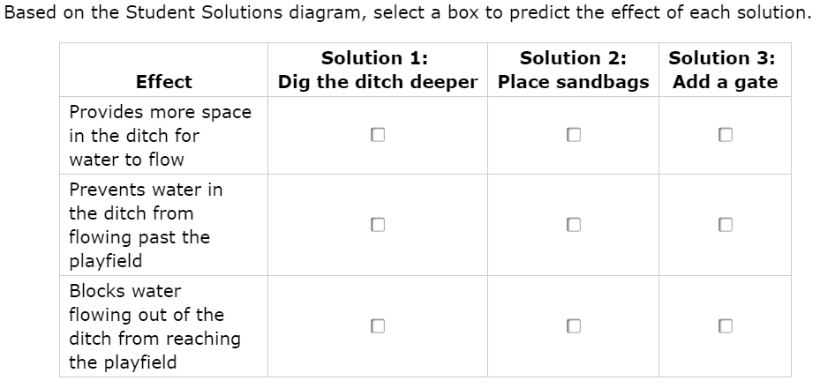
Item 2
Notes:
The second item for Soggy Solutions uses the same stimulus as item 1, so let’s go straight to Item 2 which reads:
“Based on the Student Solutions diagram, select a box to predict the effect of each solution.”
The solutions are:
“Solution 1: Dig the ditch deeper”;
“Solution 2: Place sandbags”; and
“Solution 3: Add a gate”.
The effects that students match the solutions to are:
“Provides more space in the ditch for water to flow”;
“Prevents water in the ditch from flowing past the playfield”; and
“Blocks water flowing out of the ditch from reaching the playfield.”

Slide 33
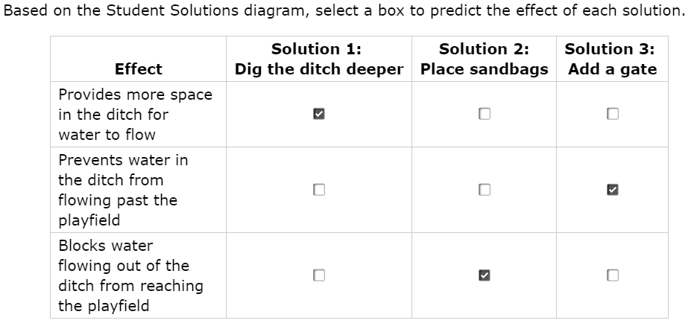
Item 2
Notes:
Here is the correct answer for item 2.
This item was also developed to align to Performance Expectation 4-ESS3-2.

Slide 34
Item 2
Notes:
Here is the set of item specifications and details and clarifications again for 4-ESS3-2.
Thinking about what students are asked to demonstrate in item 2, which specification does this item most closely align to?
During the development of this item, educator work groups determined that this is a three-dimensional item aligned to 4-ESS3-2.1. The item asks students to compare multiple solutions to a problem (SEP) by looking at the cause and effect relationships (CCC) between a solutions and they could reduce the impacts of flooding (DCI).

Slide 35
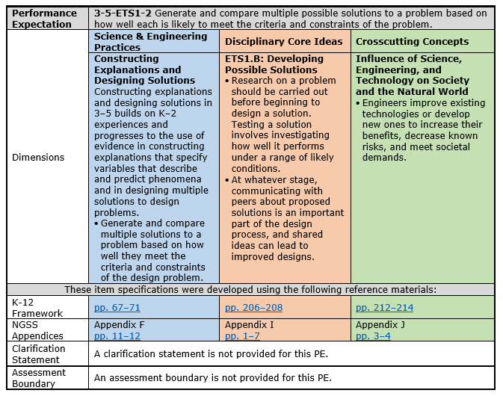
3-5-ETS1-2
Pages 110-111
Front Page
Notes:
The last two items in the Soggy Solutions cluster are aligned to Performance Expectation 3-5-ETS1-2. Let’s take a look at the item specification for that Performance Expectation. As we read through this one, please note how the format is the same as that for 4-ESS3-2. All item specifications are formatted the same way.
First, the performance expectation statement: Generate and compare multiple possible solutions to a problem based on how well each is likely to meet the criteria and constraints of the problem.
Then, the Science & Engineering Practices: Constructing Explanations and Designing Solutions
Constructing explanations and designing solutions in 3–5 builds on K–2 experiences and progresses to the use of evidence in constructing explanations that specify variables that describe and predict phenomena and in designing multiple solutions to design problems.
Generate and compare multiple solutions to a problem based on how well they meet the criteria and constraints of the design problem.
This is the same practice we had for 4-ESS3-2.
The Disciplinary Core Ideas:
ETS1.B: Developing Possible Solutions
Research on a problem should be carried out before beginning to design a solution. Testing a solution involves investigating how well it performs under a range of likely conditions.
At whatever stage, communicating with peers about proposed solutions is an important part of the design process, and shared ideas can lead to improved designs.
and the Crosscutting Concept: Influence of Science, Engineering, and Technology on Society and the Natural World
Engineers improve existing technologies or develop new ones to increase their benefits, decrease known risks, and meet societal demands.
Next, are the links to the exact pages in the K-12 Framework for Science Education and the NGSS Appendices where more information about each dimension can be found.
Noe that“A clarification statement is not provided for this PE.”, and that “An assessment boundary is not provided for this PE.”
Remember, all of the information on this page (with the exception of the links) is taken directly from the NGSS.

Slide 36
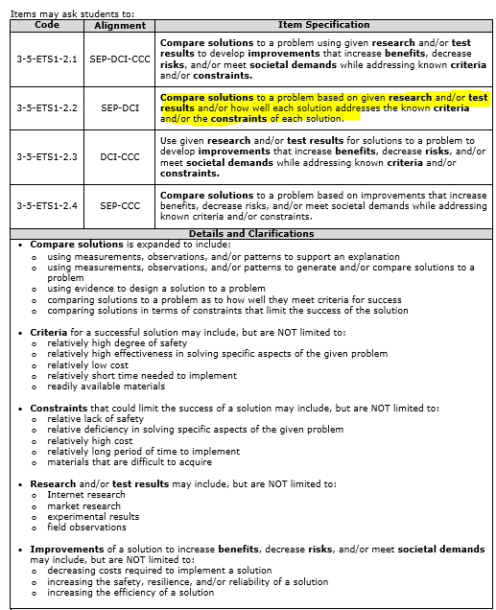
3-5-ETS1-2
Pages 110-111
Back Page
Notes:
On the back page of 3-5-ETS1-2, we start with the table of item specifications [CLICK], just like with 4-ESS3-2.
Please note that this item specification has been updated since the posting of the Test Design and item Specifications document in August 2019. The highlighted item specification for 3-5-ETS1-2.2 differs slightly from what is on p.111 of the posted 2019 document. The updated language will be reflected in the 2020 version of the Test Design and Item Specifications document.
3-5-ETS1-2.1 describes how a three-dimensional item is written to assess the SEP, DCI, and CCC.
.2 describes how a two-dimensional item is written to assess the SEP and DCI.
.3 describes how a two-dimensional item is written to assess the DCI and CCC.
.4 describes how a two-dimensional item is written to assess the SEP and CCC.
And below the item specification we have the details and clarifications [CLICK].
Since the SEP for this Performance expectation is Constructing Explanations and Designing Solutions, the first set of bullets is identical to the first set of bullets on the back page of 4-ESS3-2. This set tells all the different ways we might asses the SEP. We won’t read though these again.
The second set of bullets gives some examples of criteria for a successful solution, like:
relatively high degree of safety
relatively high effectiveness in solving specific aspects of the given problem
relatively low cost
relatively short time needed to implement
readily available materials
The third set of bullets gives some examples of constraints that could limit the success of a solution, like:
relative lack of safety
relative deficiency in solving specific aspects of the given problem
relatively high cost
relatively long period of time to implement
materials that are difficult to acquire
The fourth set of bullets gives some examples of research and/or test results, like:
Internet research
market research
experimental results
field observations
The fifth set of bullets gives some examples of improvements of a solution to increase benefits, decrease risks, and/or meet societal demands, like:
decreasing costs required to implement a solution
increasing the safety, resilience, and/or reliability of a solution
increasing the efficiency of a solution
Remember, the details and clarifications section provides EXAMPLES only, NOT exhaustive lists.

Slide 37
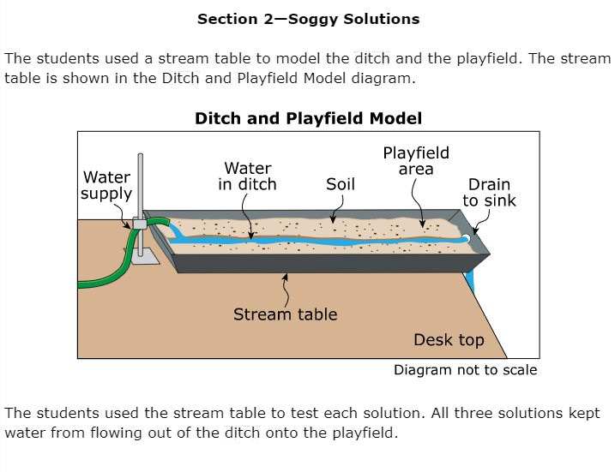
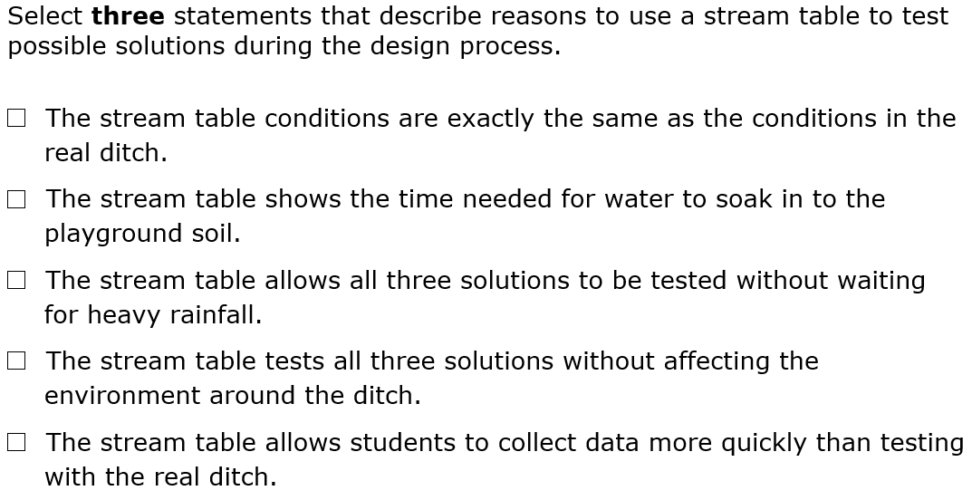
Item 3
Notes:
Now lets take a look at the section 2 stimulus in the Soggy Solutions cluster. It reads: “Section 2—Soggy Solutions. The students used a stream table to model the ditch and the playfield. The stream table is shown in the Ditch and Playfield Model diagram.”
The diagram shows a stream table siting on a desk top. The stream table includes a water supply, water in a ditch, soil, a playfield area, and a drain.
The stimulus continues: “The students used the stream table to test each solution. All three solutions kept water from flowing out of the ditch onto the playfield.
Item three is a multiple select item. It reads:
Select three statements that describe reasons to use a stream table to test possible solutions during the design process.
The stream table conditions are exactly the same as the conditions in the real ditch.
The stream table shows the time needed for water to soak in to the playground soil.
The stream table allows all three solutions to be tested without waiting for heavy rainfall.
The stream table tests all three solutions without affecting the environment around the ditch.
The stream table allows students to collect data more quickly than testing with the real ditch.

Slide 38
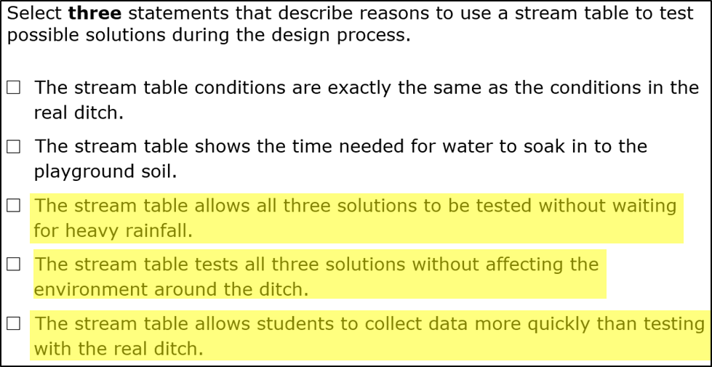
Item 3
Notes:
Here is the correct answer for item 3.
This item was developed to align to Performance Expectation 3-5 ETS1-2, which we just looked at.

Slide 39
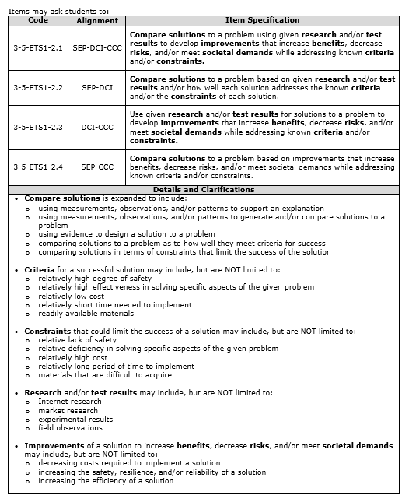
Item 3
Notes:
Here is the set of item specifications and details and clarifications again for 3-5-ETS1-2. [CLICK]
Thinking about what students are asked to demonstrate in this item, which specification does this item most closely align to?
If they are being asked to “Compare solutions to a problem using given research and/or test results to develop improvements that increase benefits, decrease risks, and/or meet societal demands while addressing known criteria and/or constraints.” then the item is three dimensional and aligned to 3-5-ETS1-2.1.
If they are being asked to “Compare solutions to a problem based on given research and/or test results and/or how well each solution addresses the known criteria and/or the constraints of each solution.” then the item is two dimensional and aligned to 3-5-ETS1-2.2.
If they are being asked to: “Use given research and/or test results for solutions to a problem to develop improvements that increase benefits, decrease risks, and/or meet societal demands while addressing known criteria and/or constraints.” then the item is two dimensional and aligned to 3-5-ETS1-2.3.
If they are being asked to: “Compare solutions to a problem based on improvements that increase benefits, decrease risks, and/or meet societal demands while addressing known criteria and/or constraints.” then the item is two dimensional and aligned to 3-5-ETS1-2.4.
This item asks students to support an explanation for using a stream table to test potential solutions . It is two dimensional and aligned to 3-5-ETS1-2.2 (SEP and DCI alignment). Because students are not asked to describe existing technologies or develop new ones to increase their benefits, decrease known risks, and meet societal demands, the item is not aligned to the CCC.

Slide 40
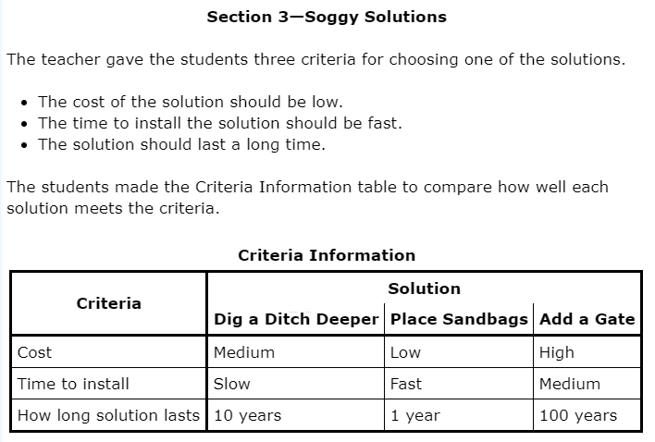
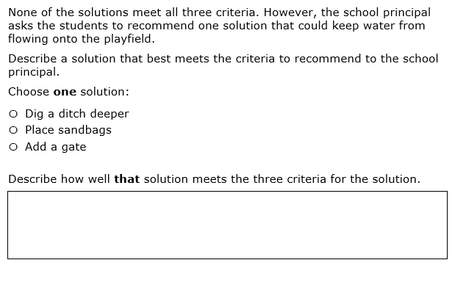
Item 4
Notes:
Now lets take a look at last stimulus and item in the Soggy Solutions cluster. The stimulus reads:
“Section 3—Soggy Solutions.
The teacher gave the students three criteria for choosing one of the solutions.
The cost of the solution should be low.
The time to install the solution should be fast.
The solution should last a long time.
The students made the Criteria Information table to compare how well each solution meets the criteria.”
The table shows that the “Dig a Ditch Deeper” solution has a medium cost, is slow to install, and lasts for 10 years. The Place Sandbags solution has a low cost, is fast to install, and lasts for 1 year. The “Add a Gate” solution has a high cost, is medium to install, and lasts for 100 years.
The fourth item is a short answer question. It reads:
“None of the solutions meet all three criteria. However, the school principal asks the students to recommend one solution that could keep water from flowing onto the playfield.
Describe a solution that best meets the criteria to recommend to the school principal.
Choose one solution:
Dig a ditch deeper
Place sandbags
Add a gate
Describe how well that solution meets the three criteria for the solution.”

Slide 41
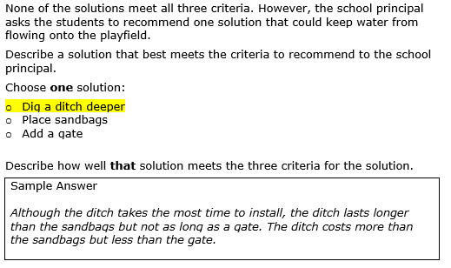
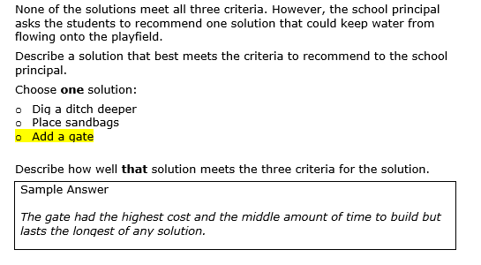
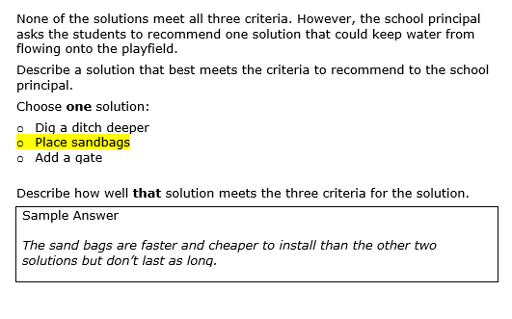
Item 4
Notes:
Here are a few sample answers for Item 4. There are other creditable answers.
This item was also developed to align to Performance Expectation 3-5 ETS1-2.

Slide 42
Item 4
Notes:
Here is the set of item specifications and details and clarifications again for 3-5-ETS1-2.
Thinking about what students are asked to demonstrate in this item, which specification does this item most closely align to?
This item asks student to choose the solution they think best meets the given criteria, and then describe how well that solution meets the given criteria. It is two dimensional and also aligned to 3-5-ETS1-2.2 (SEP and DCI alignment). Because students are not asked to describe existing technologies or develop new ones to increase their benefits, decrease known risks, and meet societal demands, the item is not aligned to the CCC.
This brings us to the end of our alignment activity. Alignment judgements are made and revisited during each step of the science assessment development process, and Washington educators are a key part of these discussions. Although making some alignment judgements is more clean cut than making others, we are confident in the process, documentation, and decisions that are used for aligning the WCAS items to the NGSS.
The alignment activity can be repeated using the four standalone items and the Rock Pocket Mice cluster from the Grade 5 Training test. Performance Expectation and answer key information for all of the training test items is found on page 7 of the Grade 5 Training Test Lesson Plan mentioned on slide 23.

Slide 43
Vocabulary Terms
Notes:
You’ll find a list of expected SEP, DCI, and CCC vocabulary terms on the last two pages of the Test Design and item Specifications document,

Slide 44
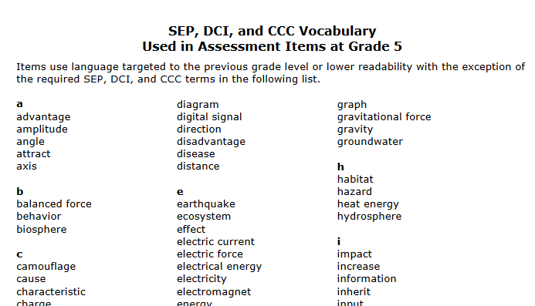
Expected
SEP, DCI, and CCC
Vocabulary
Pages 114-115
Notes:
WCAS stimuli and items use language targeted to the previous grade level or lower readability with the exception of the required SEP, DCI, and CCC terms that are included in the vocabulary list. Students are expected to know the meaning of these words when they take the WCAS, even though the words may be above grade level.
OSPI cannot endorse any particular resource or curriculum, therefore we can’t point to a particular source for definitions.

Slide 45
Q&A
Notes:
We are going to stop here and answer a few more questions that have come in.

Slide 46
Reminders & Wrap up
Notes:
Please remember that the Test Design and Items Specifications documents are intended to guide the writing of test items for the state summative assessment.
Classroom instruction should align to the Washington State K–12 Science Learning Standards (NGSS). The Test Design and Items Specifications documents can also serve as another resource, much like the NGSS Appendices, to help clarify understanding of the standards.
The Test Design and Items Specifications documents will be updated through the steps of the assessment development cycle, and a modifications log will be published that shows where changes were made.

Slide 47
Where to find the materials
WCAS Educator Resources Webpage
https://www.k12.wa.us/student-success/testing/state-testing-overview/washington-comprehensive-assessment-science/wcas-educator-resources
  Presentation slides with script 1 week out
  FAQ document with answers to Chat questions 1 week out
  Webinar recording 2 weeks out
pdEnroller
https://www.pdenroller.org/
Notes:
We will post this PowerPoint presentation, including notes with our script, on the WCAS Educator Resources Webpage by a week from today. We’ll put it in the section about the “Test Design and Item Specifications.”
An FAQ with your questions as well as a recording of the webinar will be posted next to the presentation by the end of the following week.
Remember that if you would like to receive clock hours, you need to sign in, register, and complete an evaluation of the webinar through pdEnroller.

Slide 48
Thank You!
Notes:
We will keep the webinar open for a few more minutes to capture any remaining questions you may want to enter into the chat box.
Thank you for joining us this afternoon.

